Slide 1
Customer Training Workshop
PSOC™ Control C3- PSC3M/P6
-Overview, Portfolio positioning, Architecture, Peripherals for Real time application and HandsON

Slide 2
Platinium Training Objective – PSOC™ C3M/P6
Duration : 4hour
Understand where PSC3M/P6x fits and identify its major enhancements
Become productive with the development flow, tools and available technical resources.
Understand how architectural enhancements affect real-time control performance.
Gain practical experience with key communication interfaces
Understand HPPASS /TCPWM and apply it for advanced digital-power and motor-control resources
Train-the-trainer. Attendees should be able to deliver same training to customers /FAEs

Slide 3
PSOC Control C3:
Overview, portfolio positioning, value prepositions and comparasion of PSC3M5/M6/M8 devices

Slide 4



Industrial MCU markets are growing with an increasing need for higher efficiency. PSOCTM Control targets motor control and power conversion
Industrial Microcontroller Market Segments
Target MCU Market Outlook (in bn €)
1. Motor Control
Higher system efficiency (performance, power, integration, ML)
Growth driven by Robotics and Home Appliance applications
2. Power Conversion
Higher efficiency and performance enabled by WBG (SiC/GaN)
Optimized MCU products needed for WBG solutions
3. Industrial
Communication
Evolving communication standards and user interfaces
Motor Control
5%
CAGR₂₆₋₃₁
PSOCTM Control C1
Power Conversion
PSOCTM Control C3
​
    Key trends and drivers across all Industrial MCU segments
    Common Software & Tool environments (incl. more AI/ML)
    Strong and exhaustive Ecosystems
    Functional Safety and Advanced Security
6%
CAGR₂₆₋₃₁
Source: Infineon Market Model 2026

Slide 5



PSOC™ Control is the new Industrial MCU family in Infineon’s extensive microcontroller portfolio
32-bit Arm® Cortex®-M0/M0+ | 32-bit Arm® Cortex®-M4/M33/M7 |  | 32-bit TriCore™ | 32-bit Arm® Cortex®-M55/M85, U55, M33 with ML accelerators
Auto / Functional Safety
MOTIX™
TRAVEO™ T2G
Cortex-M0 and M3, ASIL-B
Up to 256KB Flash
Motor Control SoC
Dual Cortex-M4/M7 and M0+
ASIL-B, Up to 16MB Flash
HSM, GPU (Cluster)
AURIX™ TC4x
Up to 6x Tricore ASIL-D
Up to 24MB Flash
PPU, SRM, Lockstep, PCIe
PSOC™ Multitouch
Auto PSOC™
XMC7000
AURIX™ TC3x
Touch controller SoC
Touchscreen, Slider, Touchpad
Wet-finger tracking
ASIL-B
Up to 384KB Flash
CAPSENSE
Dual Cortex-M7 and M0+
Up to 350MHz and 8MB Flash
Motor and power control
Up to 6x Tricore ASIL-D
Up to 16MB Flash
HSM, ETH, Lockstep, CAN FD
PSOC™ Fingerprint
Auto PSOC™ HV
XMC5000
AURIX™ TC2x
Touch controller SoC
Capacitive fingerprint solution
Support multi-surface solution
ASIL-C
Up to 384KB Flash
Up to 42V tolerant MCU
Dual Cortex-M4 and M0+
Up to 160MHz and 2MB Flash
Motor and power control
Up to 3x Tricore ASIL-D
Up to 8MB Flash
HSM, ETH, Lockstep, CAN FD
PSOC™ C3 Performance
PSOC™ Edge E86
180MHz M33 + PPCA
25Msps ADCs
CORDIC Math co-processor
400MHz M55/U55 and M33
Up to 9.5MB SRAM, 4MB NVM
Camera, GPU, Audio, Analog
XMC1000
PSOC C1
XMC4000
Up to 48MHz and 200KB Flash
CORDIC Math co-processor
CCU8 timer
Up to 48MHz and 200KB Flash
CORDIC Math co-processor
CAN
Up to 144MHz and 2MB Flash
Motor and power control
PSOC™ C3 Main
PSOC™ Edge E84
Up to 180MHz M33
Up to 12Msps ADCs
CORDIC Math co-processor
400MHz M55/U55 and M33
Up to 6.5MB SRAM, 0.5MB NVM
GPU, Audio, Analog
Consumer / Industrial
PSOC™ 4
PSOC™ 6
Up to 48MHz and 384KB Flash
Industry leading CAPSENSE™ Mixed-signal functionality
Dual Cortex-M4 and M0+
Up to 150MHz and 2MB Flash
Ultra-low-power with security
PSOC™ C3 Entry
PSOC™ Edge E83
Up to 100MHz M33
Up to 6Msps ADCs
CORDIC Math co-processor
400MHz M55/U55 and M33
Up to 5.5MB SRAM, 0.5MB NVM
Audio, Analog
FM0+
FM4
PSOC™ Edge E81
Up to 40MHz and 128KB Flash
Entry level USB
Up to 200MHz and 2MB Flash
High-performance motor control
400MHz M55 and M33
Up to 5.5MB SRAM, 0.5MB NVM
Audio, Analog

Slide 6





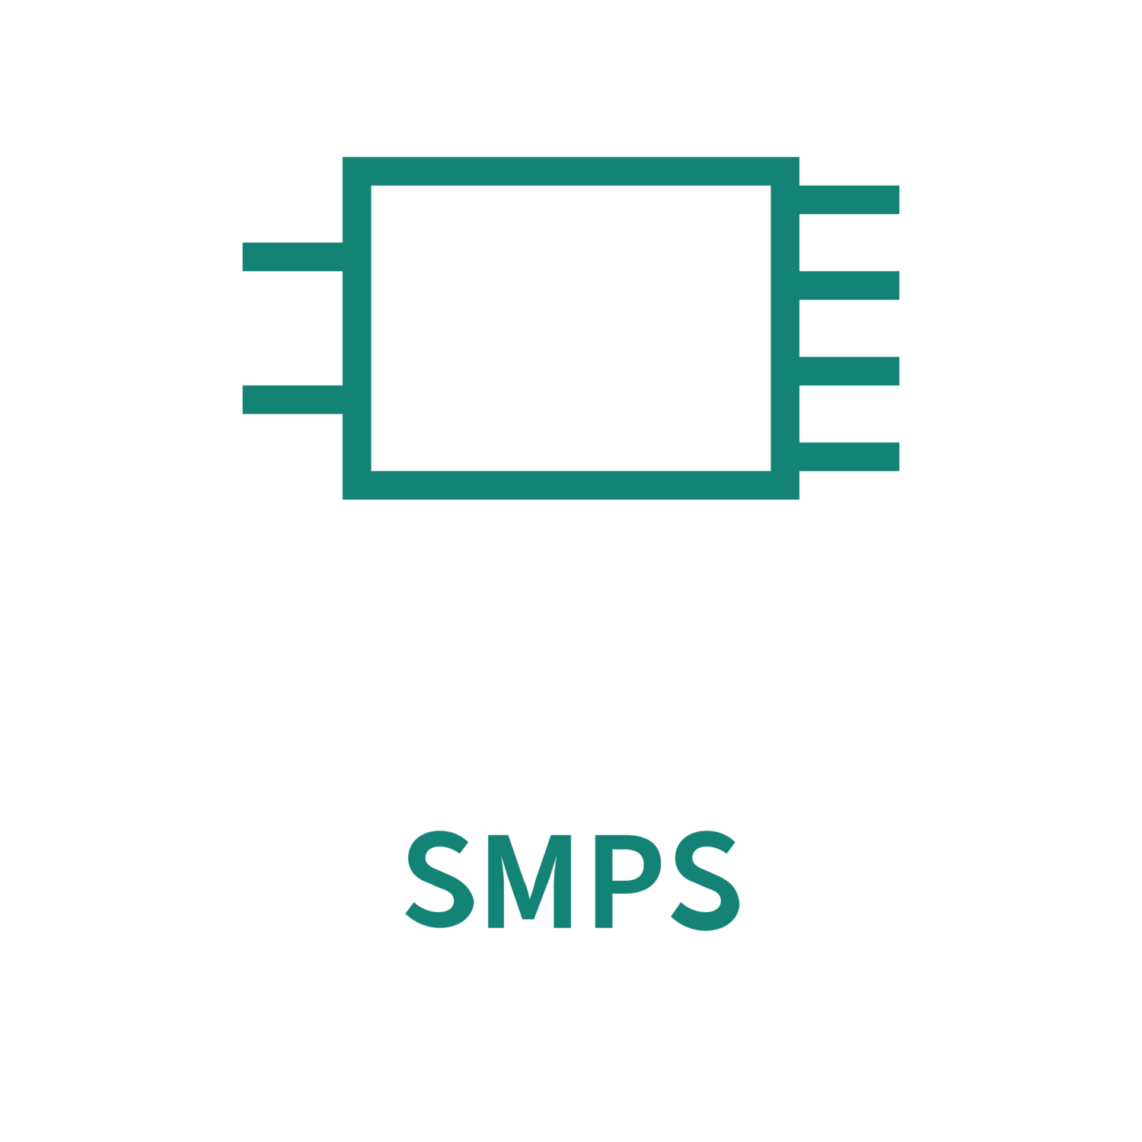









PSOC™ Control – Infineon’s new microcontroller family for a variety of motor control and power conversion applications
PSOC™ Control C1
Arm® M0 48 MHz
Entry-level product for simple motor control
38- to 48-pin TSSOP, QFN & QFP packages
Lead applications:
PSOC™ Control C3
Arm® Cortex®-M33 up to 180 MHz
Single core (+PPCA) with up to 512KB Flash and 128KB RAM
40- to 100-pin QFN and QFP packages
First products available, full portfolio by end of 2026
Lead applications:
PSOC™ Control C4
Arm® Cortex®-M33 up to 250 MHz
Single and dual core with up to 2MB Flash and 512KB RAM
EtherCAT, SPE and Ethernet TSN
Lead applications:
PSOC™ Control C8
Arm® Cortex®-M85
EtherCAT and Ethernet
PSOCTM
C8M/Px
PSOCTM
C8M/Px
PSOCTM
C4M/P5
PSOCTM
C3M/P7-8
PSOCTM
C4M/P3
PSOCTM
C3M/P6
PSOCTM
C3M/P2-5
PSOCTM
C3M/P1
Available/Sampling
In Development
In Definition
Planned
Feature integration
PSOCTM
C1M2-3
Core Frequency
>100 MHz
>200 MHz
>400 MHz

Slide 7
PSOC™ Control Portfolio – Launching several new microcontrollers in 2026 to complete and expand PSOC™ Control C3 portfolio
PSOC™ Control Portfolio
Available/Sampling
In Development
In Definition
Key Features
PSOC™ Control C4
250MHz dual Cortex®-M33 + advanced mixed signal
+ industrial communication
Up to 1024KB Flash
Up to 768KB RAM
C4P5/M5
PSOC™ Control C3 Performance Line
180MHz single Cortex®-M33 with dual 200MHz PPCA
Up to 512KB Flash
128KB RAM (112KB PPCA)
C3M/P7-8
PPCA, 4x 25 MSPS ADC, HRPWM, CORDIC, DAC, PSA L3, PQCs
256-512KB Flash
128KB RAM
C3P6/M6
OpAmps, HRPWM, CORDIC, DAC, I3C, CAN, USB, PSA L3, PQC
PSOC™ Control C3 Main Line
180MHz single Cortex®-M33 +
advanced mixed signal
128-256KB Flash
64KB RAM
C3P5/M5
HRPWM, CORDIC, CAN, PSA L2
128-256KB Flash
64KB RAM
Pin Compatible Main & Entry Line
C3P4/M4
OpAmps, PSA L2
128-256KB Flash
32-64KB RAM
Frequency/Real-Time Performance
PSOC™ Control C3 Entry Line
100MHz single Cortex®-M33
C3P2/M3
CORDIC, CAN, PSA L2
128-256KB Flash
32-64KB RAM
C3P1/M1
OpAmps
PSOC™ Control C1
Up to 48MHz single Cortex®-M0
64-200KB Flash
16KB RAM
C1M2/3
5.5V, CAN
Packages/Feature Integration
38 pin
TSSOP
40 pin
QFN
48 pin
QFN/QFP
64 pin
QFN/QFP
80 pin
QFP
100 pin
QFP
Up to 176 pin
QFP/BGA

Slide 8
PSOCTM Control C3 Main Line with ARM® Cortex® M33 at 180MHz
Portfolio and Device Overview
Flash memory size /
RAM size (KB)
PSOCTM Control C3 with full SW and P2P compatibility
Other parts from PSOCTM C3 Performance Line
512K / 128K
PSC3M6GES3ACQ1
PSC3M6GES3AFQ1
PSC3M6GES3AHQ1
PSOCTM C3 Main Line
ARM® Cortex® M33 at 180MHz
DSP/FPU and CORDIC (option)
12-bit ADC up to 12-MSPS
w/ 16 S&H
16/32-bit TCPWM
100ps HRPWM (option)
Up to PSA L3 Security
PSC3P6GES3ACQ1
PSC3P6GES3AFQ1
PSC3P6GES3AHQ1
PSC3M6FDS2ACQ1
PSC3M6FDS2AFQ1
PSC3M6FDS2AHQ1
256K / 64K
PSC3P6FDS2ACQ1
PSC3P6FDS2AFQ1
PSC3P6FDS2AHQ1
PSC3M5FDS2LGQ1
PSC3M5FDS2ABQ1
PSC3M5FDS2LHQ1
PSC3M5FDS2ACQ1
PSC3M5FDS2AFQ1
PSC3P5FDS2LGQ1
PSC3P5FDS2ABQ1
PSC3P5FDS2LHQ1
PSC3P5FDS2ACQ1
PSC3x6 series with
Up to PSA L3, PQC and USB
PSC3M4FDS1LEQ1
PSC3M4FDS1LGQ1
PSC3M4FDS1ABQ1
PSC3M4FDS1ACQ1
Pin compatible parts from PSOC™ Control C3 Entry Line
PSC3x6 series with
Up to PSA L3 and PQC
128K / 32-64K
PSC3M5EDLGQ1
PSC3M5EDABQ1
PSC3M5EDLHQ1
PSC3M5EDACQ1
PSC3M5EDAFQ1
PSC3x5 series with PSA L2
PSC3P5EDLGQ1
PSC3P5EDABQ1
PSC3P5EDLHQ1
PSC3P5EDACQ1
PSC3x4 series with PSA L1
PSC3M4EDS1LEQ1
PSC3M4EDS1LGQ1
PSC3M4EDS1ABQ1
PSC3M4EDS1ACQ1
PSC3P4ECS1LEQ1
PSC3P4ECS1LGQ1
PSC3P4ECS1ABQ1
PSC3P4ECS1ACQ1
PSC3M: Motor (Cordic + MOTIF)
PSC3P: Power (PMBus)
Pin compatible parts from PSOC™ Control C3 Entry Line
Pin Count Package Size
QFN40
5x5mm
0.4mm pitch
QFN48
6x6mm
0.4mm pitch
QFP48
7x7mm
0.5mm pitch
QFN64
8x8mm
0.4mm pitch
QFP64
10x10mm
0.5mm pitch
QFP80
12x12mm
0.5mm pitch
QFP100
14x14mm
0.5mm pitch

Slide 9
PSOC™ Control C3 Main Line
PSC3M/P5 (Available)
Block diagram
Applications and Target Markets
Single and dual motor control, and PFC
PFC, Power & Gardening tools, MHA and Aircon drives and compressors, LEV drives, SPMS, Solar, EV Charging
Product Highlights
Low power modes: deep sleep (<10uA), sleep, hibernate (<1uA)
Idle sampling ADC:
  Low jitter and high performance, obsoleting external buffer caps
  12 MSPS, 16 ch sync. sampling, 16-bit oversampling, in-built gain
Comparators: < 10ns in-built 10-bit DAC and slope generator
10-clock-cycles CORDIC Accelerator
Timer/Counter/PWM (TCPWM):
  Complementary output/ch, multi-ch control, shadow update, input glitch filter, PRNG dithering
  < 100 ps high resolution PWM (HRPWM) for period, duty & dead time
TriggerMux: < 1ns latency programmable peripheral interconnects
Memory:
  Up to 256kB RWW Flash @ 20 Mhz, ECC on Flash & RAM
  16 kB Instruction Cache
Security: PSA L2 certified, Configurable Flash Partitioning / Protection
Safety: Class B & SIL 2 compliant
Operating Range
  1.71 – 3.3V
  <1 – 10 µA low power modes
  -40 – 115°C Ta, 125°C Tj
SYSTEM
ARM®
Cortex-M33
DSP/FPU
TrustZone
180MHz
16 kB
I-Cache
64kB
Boot ROM
MPU
Secure/non secure
48 MHz
8 MHz
32.768 kHz
64kB SRAM ECC
deep sleep retention
2x 16-ch
DMA
4-ch
IPC
External crystal oscillator I/F
SAU
128-256KB
RWW flash
ECC
2 independent WDT
PLL/FLL
REAL TIME CONTROL
Temp. sensor
SWD/JTAG/ Trace/Boundary scan
12-bit 12-Msps SAR ADC
Up to 18-ch
5x Comparator w/ 10-bit DAC
(2x deep sleep)
CORDIC accelerator (optional)
COMMUNICATION
TriggerMux
2-ch; CAN-FD up to 8 Mbps
6x SCB (UART, SPI, I2C), 1x deep sleep, PMBus
TCPWM timer
SECURITY
I/O
4-ch 32-bit HRPWM
16-ch 16-bit
Crypto accelerator
Up to 55 GPIO, 28 analog
Encoder/Hall I/F*
TRNG
28x Smart I/Os
Status/Availability
In Production
Packages
  QFP-48
  (7x7mm, 0.5mm)
  QFN-48
  (6x6mm, 0.4mm)
  QFP-80 (12x12mm, 0.5mm)
  QFP-64 (10x10mm, 0.5mm)
  QFN-64
  (8x8mm, 0.4mm)

Slide 10
PSOC™ Control C3 Main Line
PSC3M/P6 (Sampling)
Block diagram
Applications / Target Markets
  Single and dual motor control and PFC, tri-motor control.
  MHA and Aircon drives and compressors, SPMS, Solar, Robotics, Industrial Drives
  Product Highlights
Low power modes – deep sleep (<10uA), sleep, hibernate (<1uA)
Idle sampling ADC:
    Low jitter and high performance, obsoleting external buffer caps
    9 Msps, 16 ch sync. sampling, 16-bit oversampling, in-built gain
Comparators: 11ns in-built 10-bit DAC and slope generator
R2R DAC with buffer for external output
Timer/Counter/PWM (TCPWM):
  Complementary output/ch, multi-ch control, shadow update, input glitch filter, PRNG dithering
  < 100 ps high resolution PWM (HRPWM) for period, duty & dead time
TriggerMux: < 1ns latency programmable peripheral interconnects
Memory:
  Up to 512kB RWW Flash, ECC on Flash & RAM
  16 kB Instruction Cache
10-clock-cycles CORDIC Accelerator
Security: PSA L3 ready, PQC ready, Configurable Flash
Safety: Class B & SIL 2 capable
  Operating range
  1.71 – 3.6V
  <1 – 10 µA low power modes
  125°C Tj
SYSTEM
ARM®
Cortex-M33
DSP/FPU
TrustZone
180MHz
16 kB
I-Cache
64 kB
Boot ROM
MPU
Secure/non secure
48 MHz
8 MHz
32.768 kHz
Up to 128 kB SRAM ECC
deep sleep retention
2x 16-ch
DMA
4-ch
IPC
External crystal oscillator I/F
SAU
Up to 512kB
RWW flash, ECC
2 independent WDT
PLL/FLL
REAL TIME CONTROL
Temp. sensor
SWD/JTAG/ Trace/ Boundary scan
12-bit 9-Msps SAR ADC
Up to 24-ch
CORDIC accelerator
3P3Z Filter
COMMUNICATION
6x SCB (UART, SPI, I2C, PMBus), 1 x deep sleep
2x LPCOMP
(deep sleep)
9x Comparator w/ 10-bit DAC
2-ch CAN-FD 8 Mbps
TriggerMux
4x OpAmps
2x 12-bit DAC with buffer for output
1x I3C
USB-FS
SECURITY
I/O
TCPWM timer
Crypto accelerator
(SHA2-384)
Up to 70 GPIOs,
16 analog
8-ch 32-bit
(HRPWM)
16-ch 16-bit
2 x Encoder/Hall I/F
TRNG
7x Smart I/O
Status/Availability
Samples / EVK – Available
Qualified Samples – Available
SOP – Q4 2026
Packages
  QFP-64 (10x10mm, 0.5mm)
  QFP-80 (12x12mm, 0.5mm)
  QFP-100 (14x14mm, 0.5mm)

Slide 11
PSOC™ Control C3 – Microcontroller Family Overview
Delta between PSC3M/P5 vs PSC3M/P6
 | PSOC™ Control C3 Entry Line |  |  | PSOC™ Control C3 Main Line |  | PSOC™ Control C3 Performance Line
Variant | C3M1 / C3P1 | C3M3 / C3P2 | C3M4 / C3P4 | C3M5 / C3P5 | C3M6 / C3P6 | C3M7-8 / C3P7-8
Processing | Single Core M33 @100MHz | Single Core M33 @100MHz | Single Core M33 @180MHz | Single Core M33 @180MHz |  | Single Core M33 @180MHz
Accelerator | No | CORDIC | No | CORDIC | CORDIC, 3x3p3z filters | PPCA (2x M33 @200MHz), CORDIC
Memory | Up to 256KB Flash 32-64kB RAM | Up to 256KB Flash 32kB RAM | Up to 256KB Flash 64kB RAM | Up to 256KB Flash 64kB RAM( ECC+RWW) | Up to 512KB Flash 128kB RAM( ECC+RWW) | Up to 512KB Flash 128kB RAM (112kB PPCA)
Analog Peripherals | 5 Msps 22 ch. 4x S/H 3x OpAmps | 6 Msps 16 ch. 16x S/H | 9 Msps 22 ch. 4x S/H 3x OpAmps | 12 Msps 18 ch. 16 S/H, 5 CSG | 9 Msps 24 ch. 16 S/H 4x OpAmps, 9 CSG,2x12-bit DAC | 25 Msps 48 ch. 16 S/H 12-bit DAC
Digital Peripherals | 8x 16-bit TCPWM 4x 32-bit PWM 1x Encoder/Hall-IF | 16x 16-bit TCPWM 4x 32-bit PWM 1x Encoder/Hall-IF | 8x 16-bit TCPWM 4x 32-bit PWM 1x Encoder/Hall-IF | 16x 16-bit TCPWM 4x 32-bit PWM (HRPWM-65ps) 1x Encoder/Hall-IF | 16x 16-bit TCPWM 8x 32-bit PWM (HRPWM-100ps) 2x Encoder/Hall-IF | 12x 16-bit TCPWM 12x 32-bit PWM (HRPWM) 1x Encoder/Hall-IF
Interfaces | SCB, PMBus | SCB, PMBus | SCB, PMBus | SCB, CAN-FD, PMBus | SCB, CAN-FD, PMBus, 1x USB-FS, 1x I3C | SCB, CAN-FD, PMBus
Safety | SIL-2
Security | Up to PSA-L2 |  |  |  | PSA-L3, PQC
Packages | VQFN-40, VQFN-48, LQFP-48, LQFP-64 | VQFN-48, LQFP-48, VQFN-64, LQFP-64 | VQFN-40, VQFN-48, LQFP-48, LQFP-64 | VQFN-48, LQFP-48, VQFN-64, LQFP-64, LQFP-80 | LQFP-64, LQFP-80, LQFP-100 | VQFN-48, LQFP-48, VQFN-64, LQFP-80, LQFP-100

Slide 12
Target markets and applications
Motor control – appliances, industrial, mobility
  Power tools, gardening tools, home appliances
  Industrial drives, general-purpose drives, robotics
  HVAC compressors, dryers, aircon outdoor units
  Light electric vehicles, e-bikes, drones
Digital power conversion
  SMPS + PFC for LED, server, PC, telecom BBU
  EV chargers, on-board chargers, solar micro-inverters
  Multi-rail / multi-phase converters (digital PSU with PMBus)
Wide-bandgap technologies – SiC and GaN power stages
Smart home – secure connected controllers

Slide 13
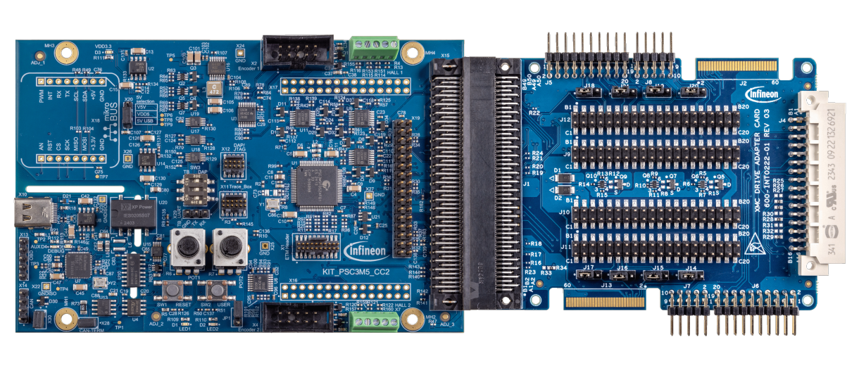
Controller - PSoC Control C3Mx setup used for the tests
Control and Computing performance meeting GaN base system requirements
Control frequency> 50kHz to enable stable control
Motor Control Firmware able to work in high-power and high-speed regime
Advanced motor control software to enable on-the-fly debugging and system troubleshooting
ARM Cortex M-33 guarantees low-power working modes
Versatile analog to digital converter
Rapid conversion and data transmission time cannot bottleneck control frequency requirement
Instantaneous Over Current Protection with analog comparators and programmable digital to analog converters
Autonomous Controller enabling customized debugging methods
Highest Performance at affordable price
Perfect feature set match for GaN enablement projects – strong focus on ADC, PWM and CPU for Motor Control
Scalable portfolio of packages and memory in multiple product families
Cutting-edge technology enables impressive MCU in competitive price.
Due to ARM Cortex-M33 and safety libraries, MCU meets safety and security needs
State-of-Art Pulse Width Modulation
TCPWM has to meet High Switching Frequency requirement
Flexible routing guarantees seamless porting of TCPWM to all digital pins
HRPWM functionality allowing to set accurate and ultra-short dead-time

Slide 14
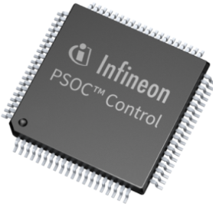
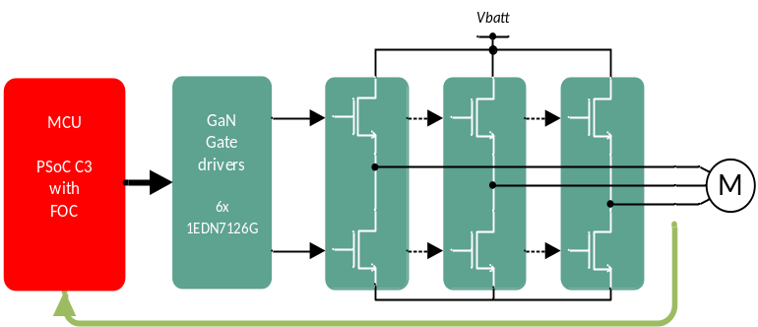
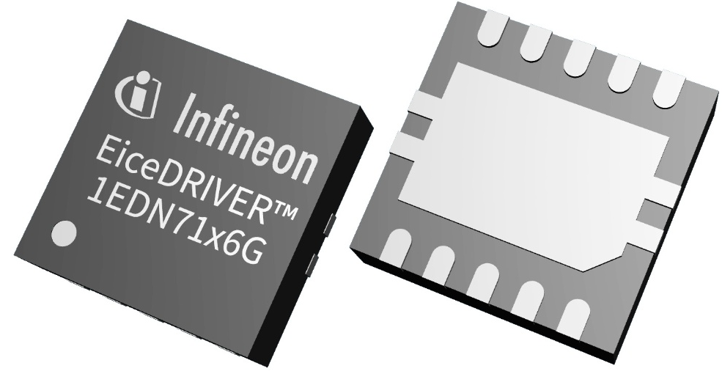
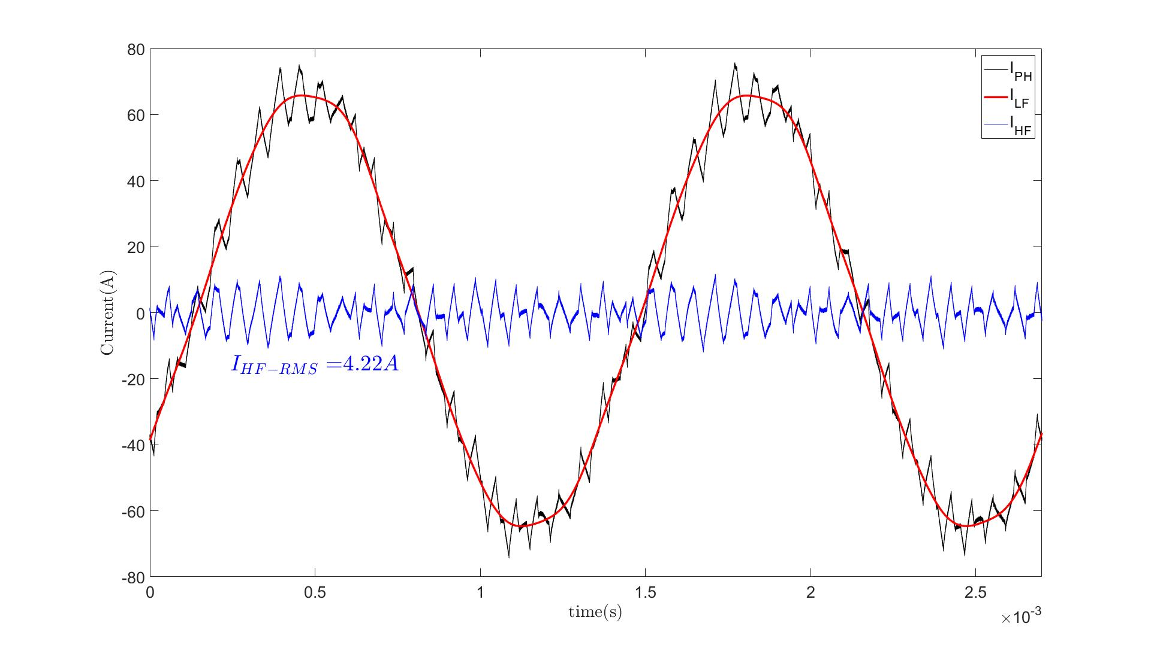
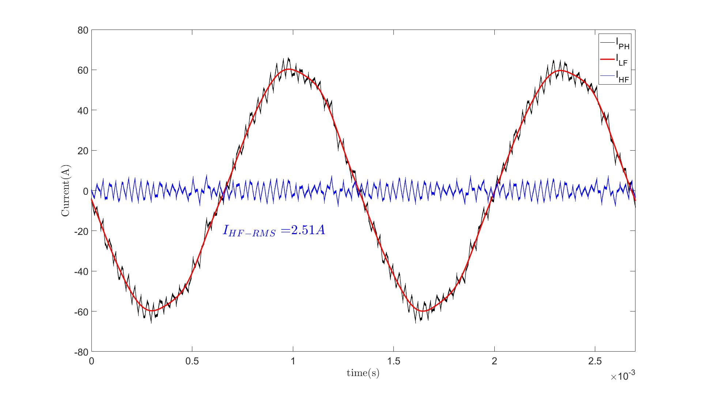
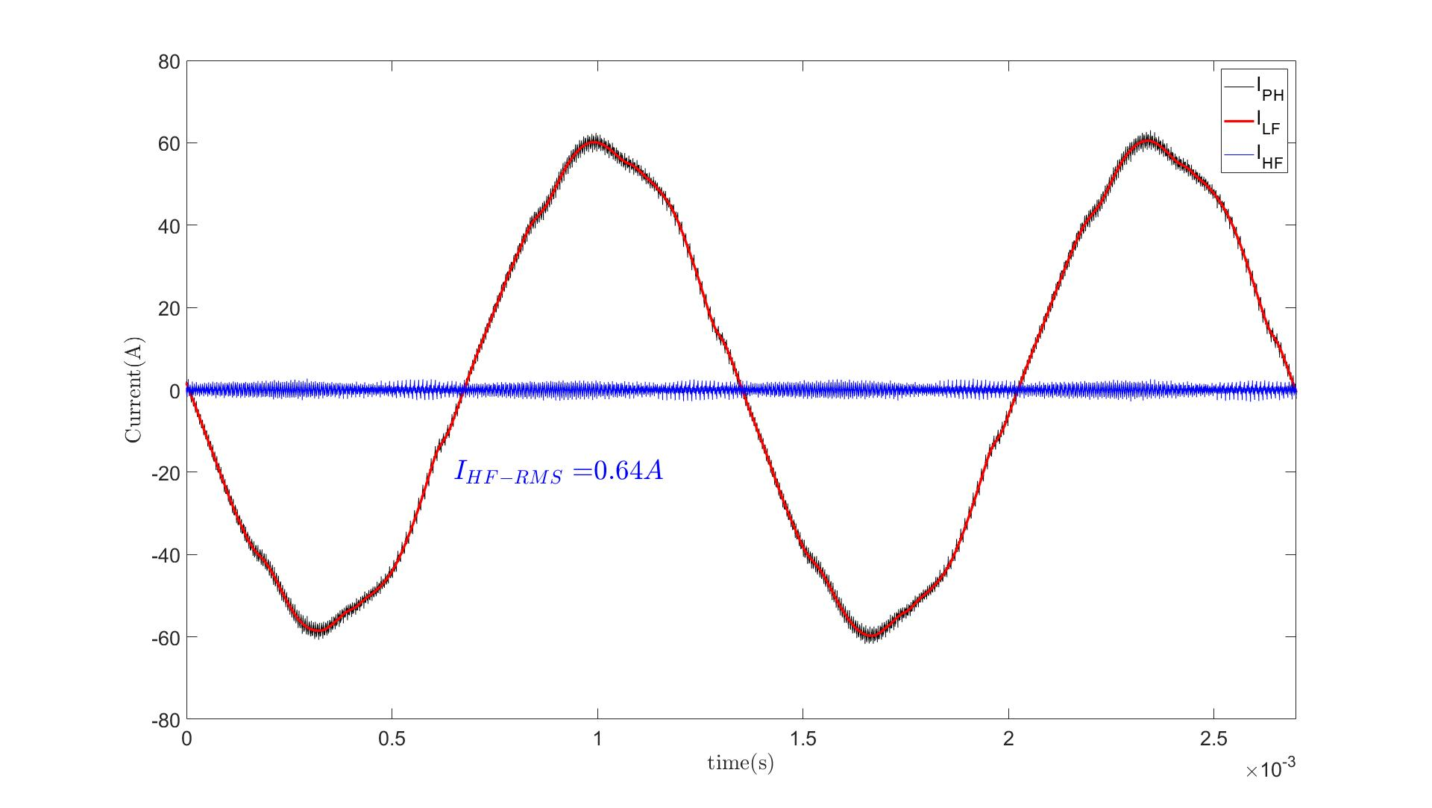
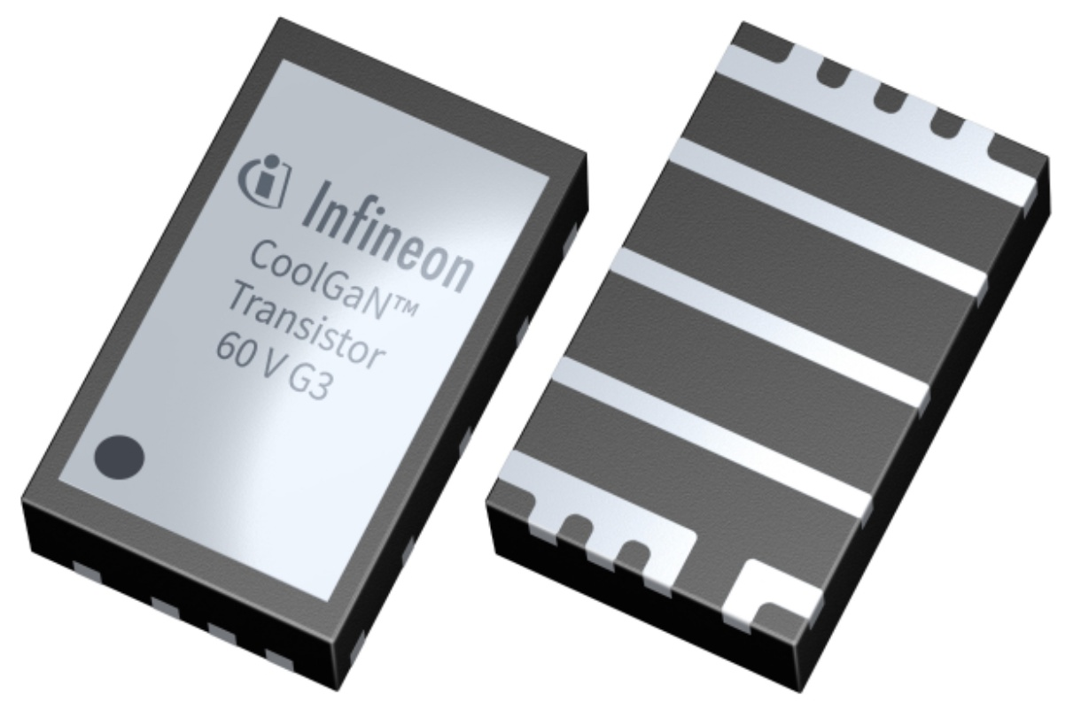
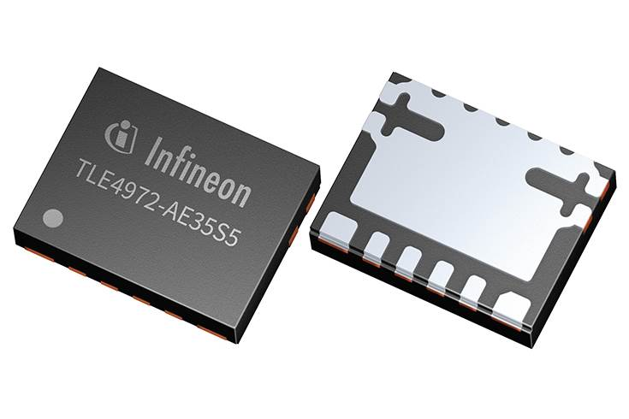
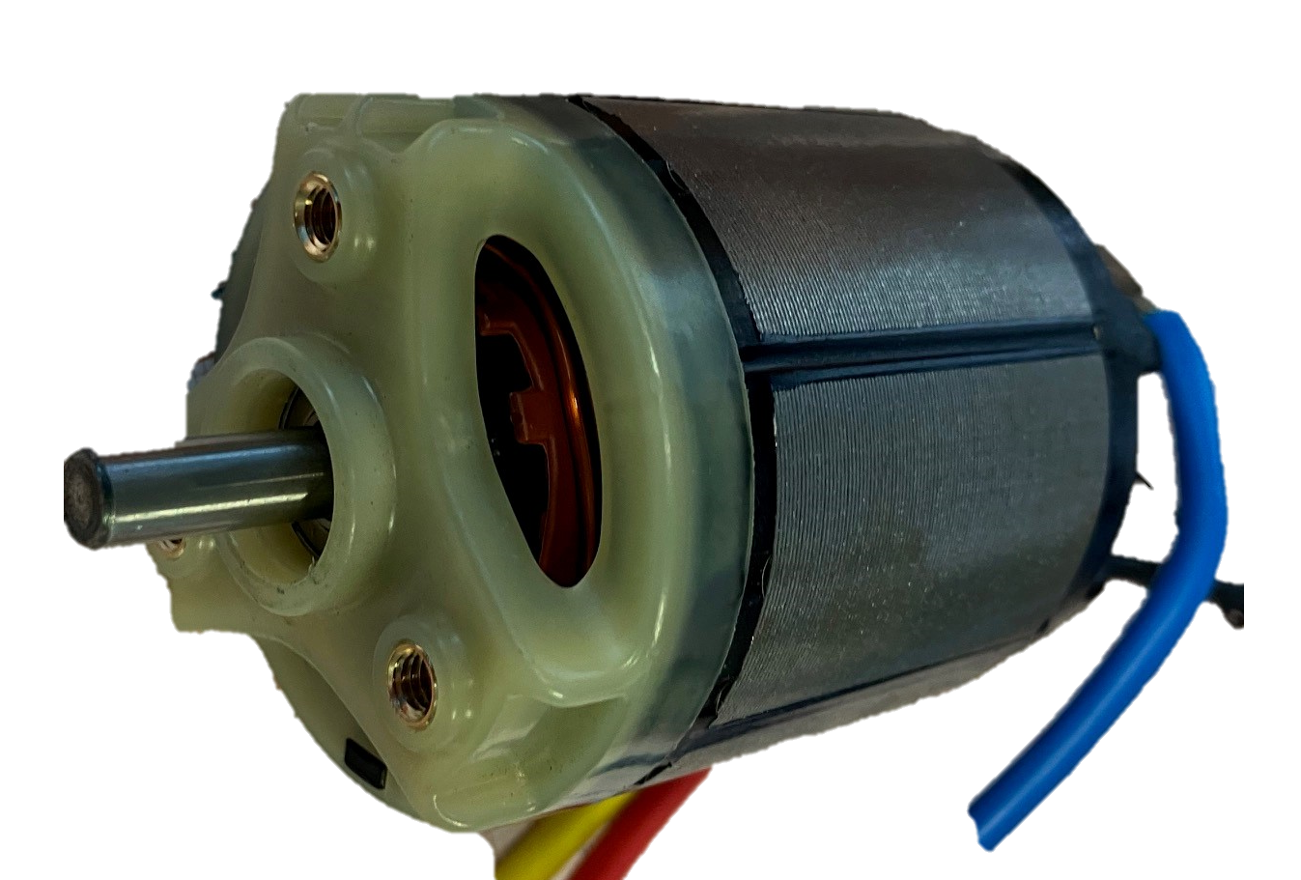
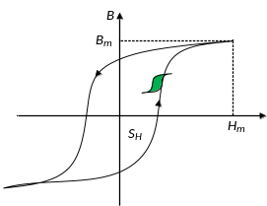
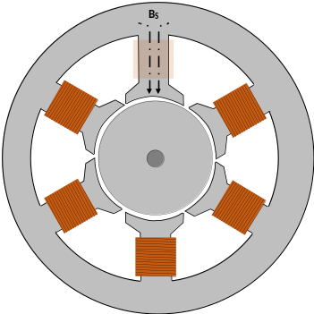
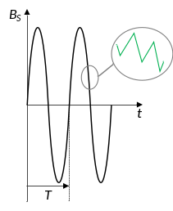

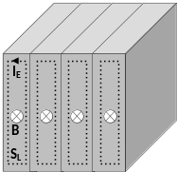
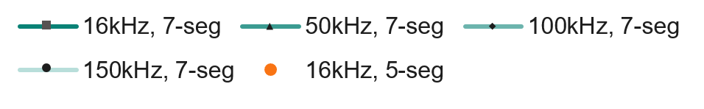




MV GaN in motor drives motor efficiency increase at higher switching frequencies up to 5-7% and reduction in motor temperature by approx 10%
Full Infineon GaN based motor drive solution including FOC firmware
Phase current ripple reduction with higher Fsw and 7-segment FOC
16kHz 5-segment
16kHz 7-segment
100kHz 7-segment
Switch
60V GaN
I_{PH_RMS}=47Arms
I_{PH_RMS}=46Arms
I_{PH_RMS}=42Arms
I_{HF_RMS}=4.22Arms
I_{HF_RMS}=2.51Arms
I_{HF_RMS}=0.64Arms
3x In-phase
current sensor TLE4972
PMS motor losses dependency on Fsw
Measurement results
$$Physt=$$
$$σH∗f∗B^{n}∗V$$
Ls=28uH, Rs=5mΩ, RPM=25000, Vin=40V, Iphase=50Arms, PP=2, M=0.5
~F_{ROT}
-10%
~F_{SW}
+5%
$$PEddy>Physt$$
Enables:
Longer battery run-time
Cheaper motor design
Enables:
Use of cheaper magnets in the motor
$$PEddy=$$
$$σE∗f^{2}∗B^{2}∗V$$
$$σE,H−material properties, f−frequency of Bs, \text{n}\text{ – 1.5 − 2.5}$$
$Bs−magnetic induction through the material,$V$− volume of material$
Notes:
When you increase Fsw from 10 kHz to 20 kHz to 100 kHz:
- Current ripple decreases
-Torque ripple decreases
-Acoustic noise decreases
But
❌ MOSFET switching losses increase linearly with Fsw
❌ Stator eddy-current losses increase due to PWM harmonics
❌ Overall efficiency can start to drop so optimum switching freq is needed
Low frequency losses → mainly hysteresis-related.
High frequency PWM harmonics → mainly eddy-current-related.
Because eddy current loss varies with $f^{2}$, increasing Fsw can make eddy-current losses become the dominant iron loss mechanism in a PMSM stator.
By using thin laminations:
current paths become smaller
eddy currents reduce
high-frequency losses reduce

Slide 15
Session :
PSOC™ Control C3M/P6
What changed vs C3M/P5 and C3M7/8?

Slide 16
PSC3M6 in one slide
vs PSC3M5: bigger and richer ( New)
vs PSC3M8: single core, no PPCA
What stays the same
• 2x memory: 512 KB flash, 128 KB SRAM
• New analog: 4 OpAmps, 2x 12-bit DAC, 3x 3P3Z filter, 9 comparators (was 5)
• New interfaces: I3C, USB-FS host/device
• New security: AES block, SHA-384/512, PQC, DICE, SVGS, PSA L3-ready
• More control: 8x 32-bit HRPWM (was 4), 2 MOTIF (was 1)
• More pins: 70 GPIO; E-LQFP-64/80/100 only
• Trade-offs: one DPLL, HPPASS at 180 MHz (ADC 9 vs 12 Msps)
• No PPCA: no 2x M33 @200 MHz, EPU, CLB, 112 KB PPCA SRAM
• 1 ADC @9 Msps instead of 4 ADCs @25 Msps
• 9 single-ended CSG (10-bit DAC) instead of 9 differential DCSG
• Unique to PSC3M6: I3C, USB-FS, OpAmps, Smart I/O
• 2 DMA (CRC) vs 1; IPC 4 vs 8; 6 SCB vs 7
• Standalone CORDIC (M parts) instead of 2x in PPCA
• Same: 512 KB / 128 KB, AES, SVGS, packages, 6 power modes
• Cortex-M33 @180 MHz, DSP, FPU, MPU, TrustZone, 16 KB I-cache
• 64 KB ROM, 32 KB SFlash, ECC on flash and SRAM
• 2x CAN FD, 2x LPComp, RTC / backup, WDT / MCWDT
• Six power modes + ULP / MF / LP / OD profiles
• TA -40 to 115 C, Class B / SIL 2 safety
• TrustZone, protection units, secure boot flow
• Same IP blocks for TCPWM, MOTIF, HRPWM, CORDIC, SCB, CAN FD, DMA
Sources: PSC3M6 DS 002-42056 *C p1, p6-9; PSC3M5 DS 002-36032 *G p1, p6-9; PSC3M8 DS 002-39793 *D p1, p6-12.
Notes:
One-minute summary. Left: BOY2P is an evolution of BOY2 (same architecture, more of everything plus new peripherals). Middle: BOY2P is NOT a BOY4 - there is no PPCA. Customers who needed the 25-Msps ADC array / EPU / CLB for very high-frequency digital power loops stay on BOY4. Right: the common platform means drivers, TrustZone setup, TCPWM/MOTIF/CORDIC IP and tools carry over.

Slide 17
Scorecard: headline numbers
PSC3M5 | PSC3M6(baseline) | PSC3M8 - main-core resources unless stated
PSC3M8: 32-bit HRPWM = 12 in PPCA + 2 on main bus; SRAM excludes 112 KB PPCA SRAM; ADC = 4 modules in PPCA. PSC3M5 GPIO 50, PSC3M6 70, PSC3M8 60 (device maximum).
Notes:
Visual anchor: BOY2P doubles memory, comparators and 32-bit HRPWM versus BOY2 and adds two DACs; BOY4 remains the throughput leader (4 ADCs at 25 Msps). Values from datasheet page 1 / detailed features of each device.

Slide 18
PSC3M6 part-number matrix: what each OPN contains
NEW
CHANGED
SAME
ABSENT
NEW = only in PSC3M6 | CHANGED = differs | SAME = identical | ABSENT = in compared device, not in PSC3M6
Package | OPN | Flash/SRAM | PSA | ADC ch | CORDIC | MOTIF | 3P3Z | CSG | USB-FS | GPIO
E-LQFP-100 | PSC3M6GES3AHQ1 | 512 / 128 | L3 | 24 | Y | 2 | Y | 9 | 1 | 68
 | PSC3P6GES3AHQ1 | 512 / 128 | L3 | 24 | - | - | Y | 9 | - | 70
 | PSC3M6FDS2AHQ1 | 256 / 64 | L2 | 24 | Y | 2 | N | 6 | 1 | 68
 | PSC3P6FDS2AHQ1 | 256 / 64 | L2 | 24 | - | - | Y | 9 | - | 70
E-LQFP-80 | PSC3M6GES3AFQ1 | 512 / 128 | L3 | 24 | Y | 2 | Y | 9 | - | 54
 | PSC3P6GES3AFQ1 | 512 / 128 | L3 | 24 | - | - | Y | 9 | - | 54
 | PSC3M6FDS2AFQ1 | 256 / 64 | L2 | 24 | Y | 2 | N | 6 | - | 54
 | PSC3P6FDS2AFQ1 | 256 / 64 | L2 | 24 | - | - | Y | 9 | - | 54
E-LQFP-64 | PSC3M6GES3ACQ1 | 512 / 128 | L3 | 19 | Y | 2 | Y | 9 | - | 39
 | PSC3P6GES3ACQ1 | 512 / 128 | L3 | 19 | - | - | Y | 9 | - | 39
 | PSC3M6FDS2ACQ1 | 256 / 64 | L2 | 19 | Y | 2 | N | 6 | - | 39
 | PSC3P6FDS2ACQ1 | 256 / 64 | L2 | 19 | - | - | Y | 9 | - | 39
M variants carry CORDIC and 2 MOTIF; P variants have neither. USB-FS exists only on the 100-pin M parts (Port 11 is a GPIO port on parts without USB).
256 KB M parts lose the 3P3Z filters and have 6 CSG instead of 9; PSA L3 applies only to 512 KB parts. All parts: 2x CAN FD, 12-bit 9-Msps ADC, 2x 12-bit DAC, 4x AFE, 6 SCB, 1x I3C, SVGS, CryptoLite + AES.
Source: PSC3M6 DS 002-42056 *C, Table 65 'Ordering information' (p86-88) and p17 PSA note. Workbook rows treated 'MOTIF 2 / 3P3Z / USB' as device-wide - they are variant-dependent.
Notes:
FAE watch-out #1: the headline features (USB, 3P3Z, 9 CSG, CORDIC, MOTIF, PSA L3) are NOT on every OPN. Always select the part number against the matrix before promising a feature. The workbook's 'peripheral inventory' treats these as device-level counts; the ordering table shows they are variant-dependent.

Slide 19
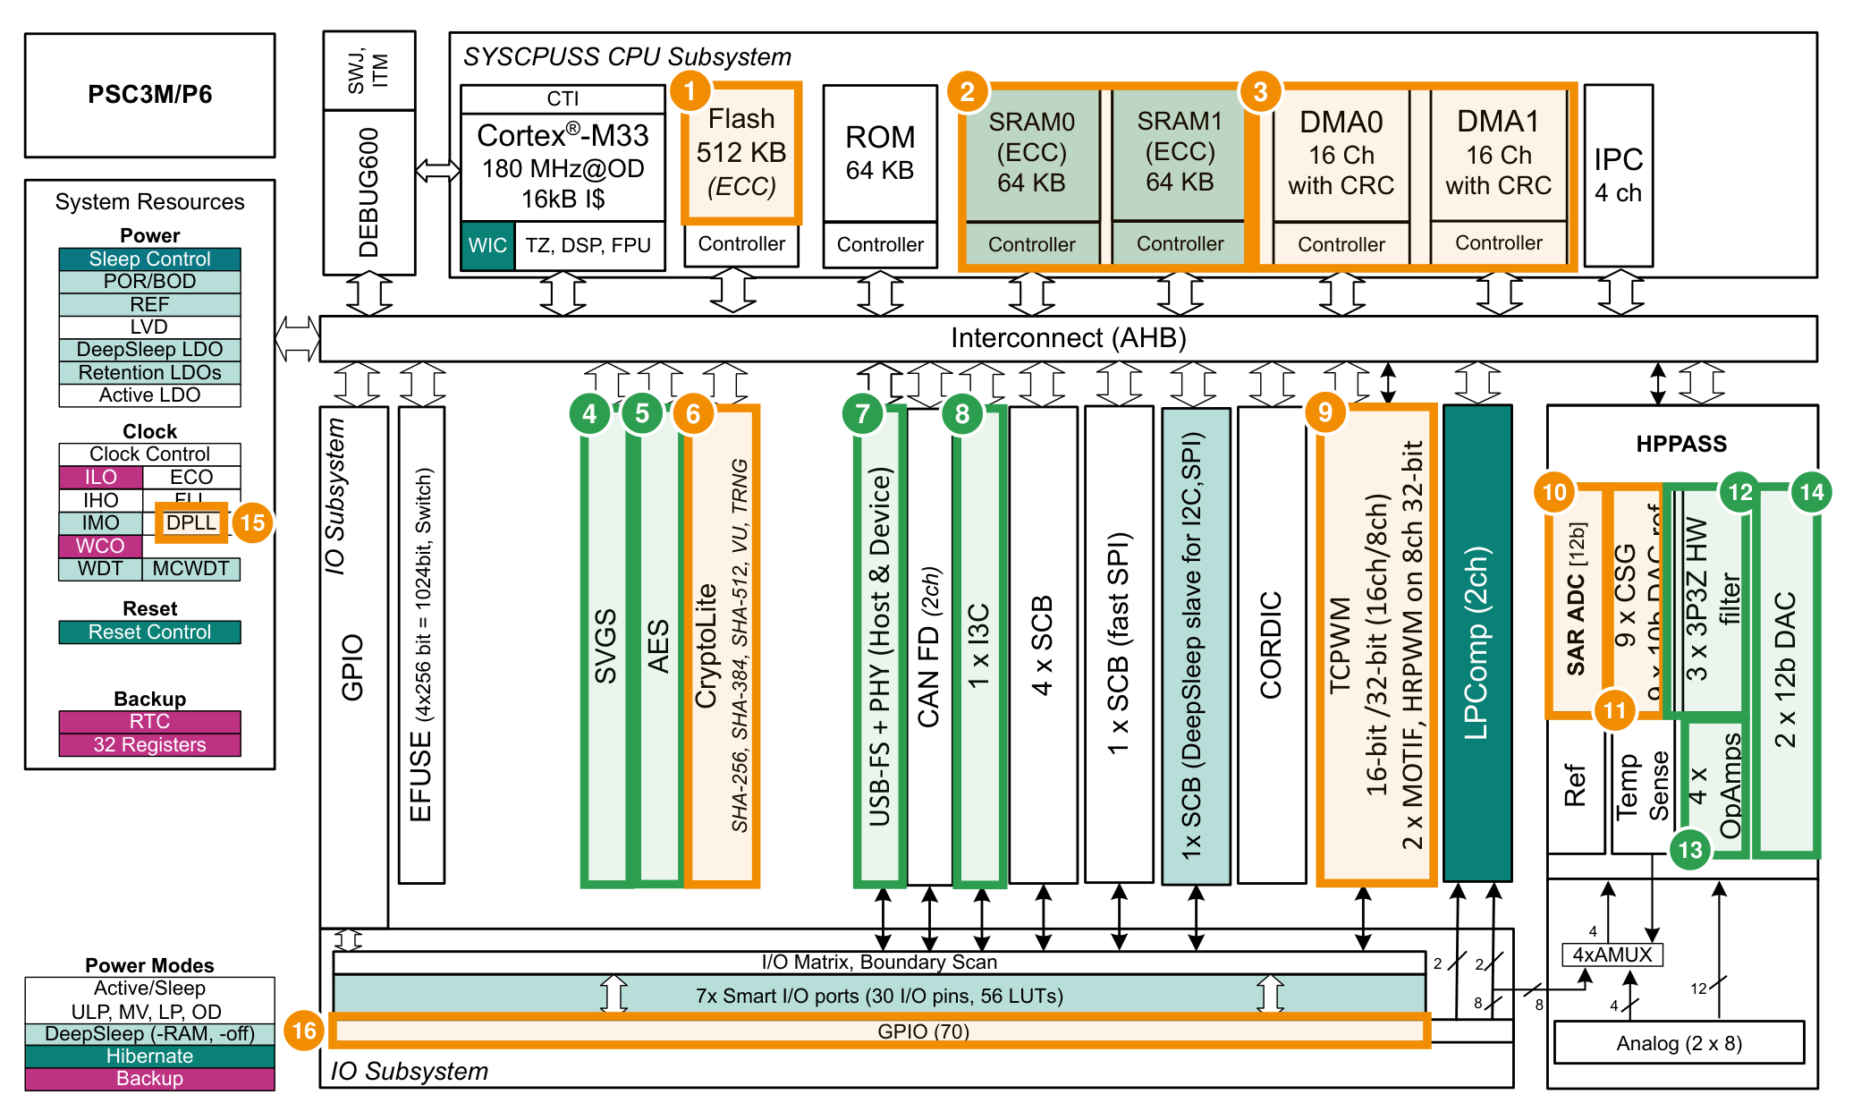
PSC3M6 functional block diagram - differences vs PSC3M5
PSC3M6 datasheet Fig.1 (PSC3M/P6): green = NEW block, orange = changed value
1
Flash 512 KB (PSC3M5: 256 KB) - 2x
2
SRAM 2 x 64 KB = 128 KB (PSC3M5: 64 KB) - 2x
3
DMA0/DMA1: 16 ch each, now with configurable CRC
4
SVGS - supply voltage glitch sensor (new block)
5
AES - dedicated AES-128/256 engine (new block)
6
CryptoLite adds SHA-384/512 (PSC3M5: SHA-256 only)
7
USB-FS host/device + PHY (new, PSC3M6-unique)
8
I3C interface (new, PSC3M6-unique)
9
TCPWM: 8x 32-bit HRPWM (PSC3M5: 4x) + 2x MOTIF (PSC3M5: 1x)
10
SAR ADC: 9 Msps, 24 inputs, 16 S/H (PSC3M5: 12 Msps)
11
CSG: 9 comparators (PSC3M5: 5)
12
3x 3P3Z hardware filter (new)
13
Up to 4 OpAmps (new, PSC3M6-unique)
14
2x 12-bit R2R DAC (new)
15
1 DPLL (PSC3M5: 2 DPLL) - reduced
16
70 GPIO + 16 dedicated analog (PSC3M5: 50 + 16)
Source: PSC3M6 DS 002-42056 *C, Figure 1 (p6); PSC3M5 DS 002-36032 *G, Figure 1 (p6).
Notes:
Walk the picture left to right. Memory (1-3), then security column (4-6: SVGS, AES, CryptoLite), then the new communication blocks (7-8: USB, I3C), real-time control (9) and the HPPASS (10-14). 15: only one DPLL. 16: GPIO. Unchanged blocks (ROM, IPC, SCB count, CAN FD, CORDIC, LPComp, debug) are intentionally unmarked.

Slide 20
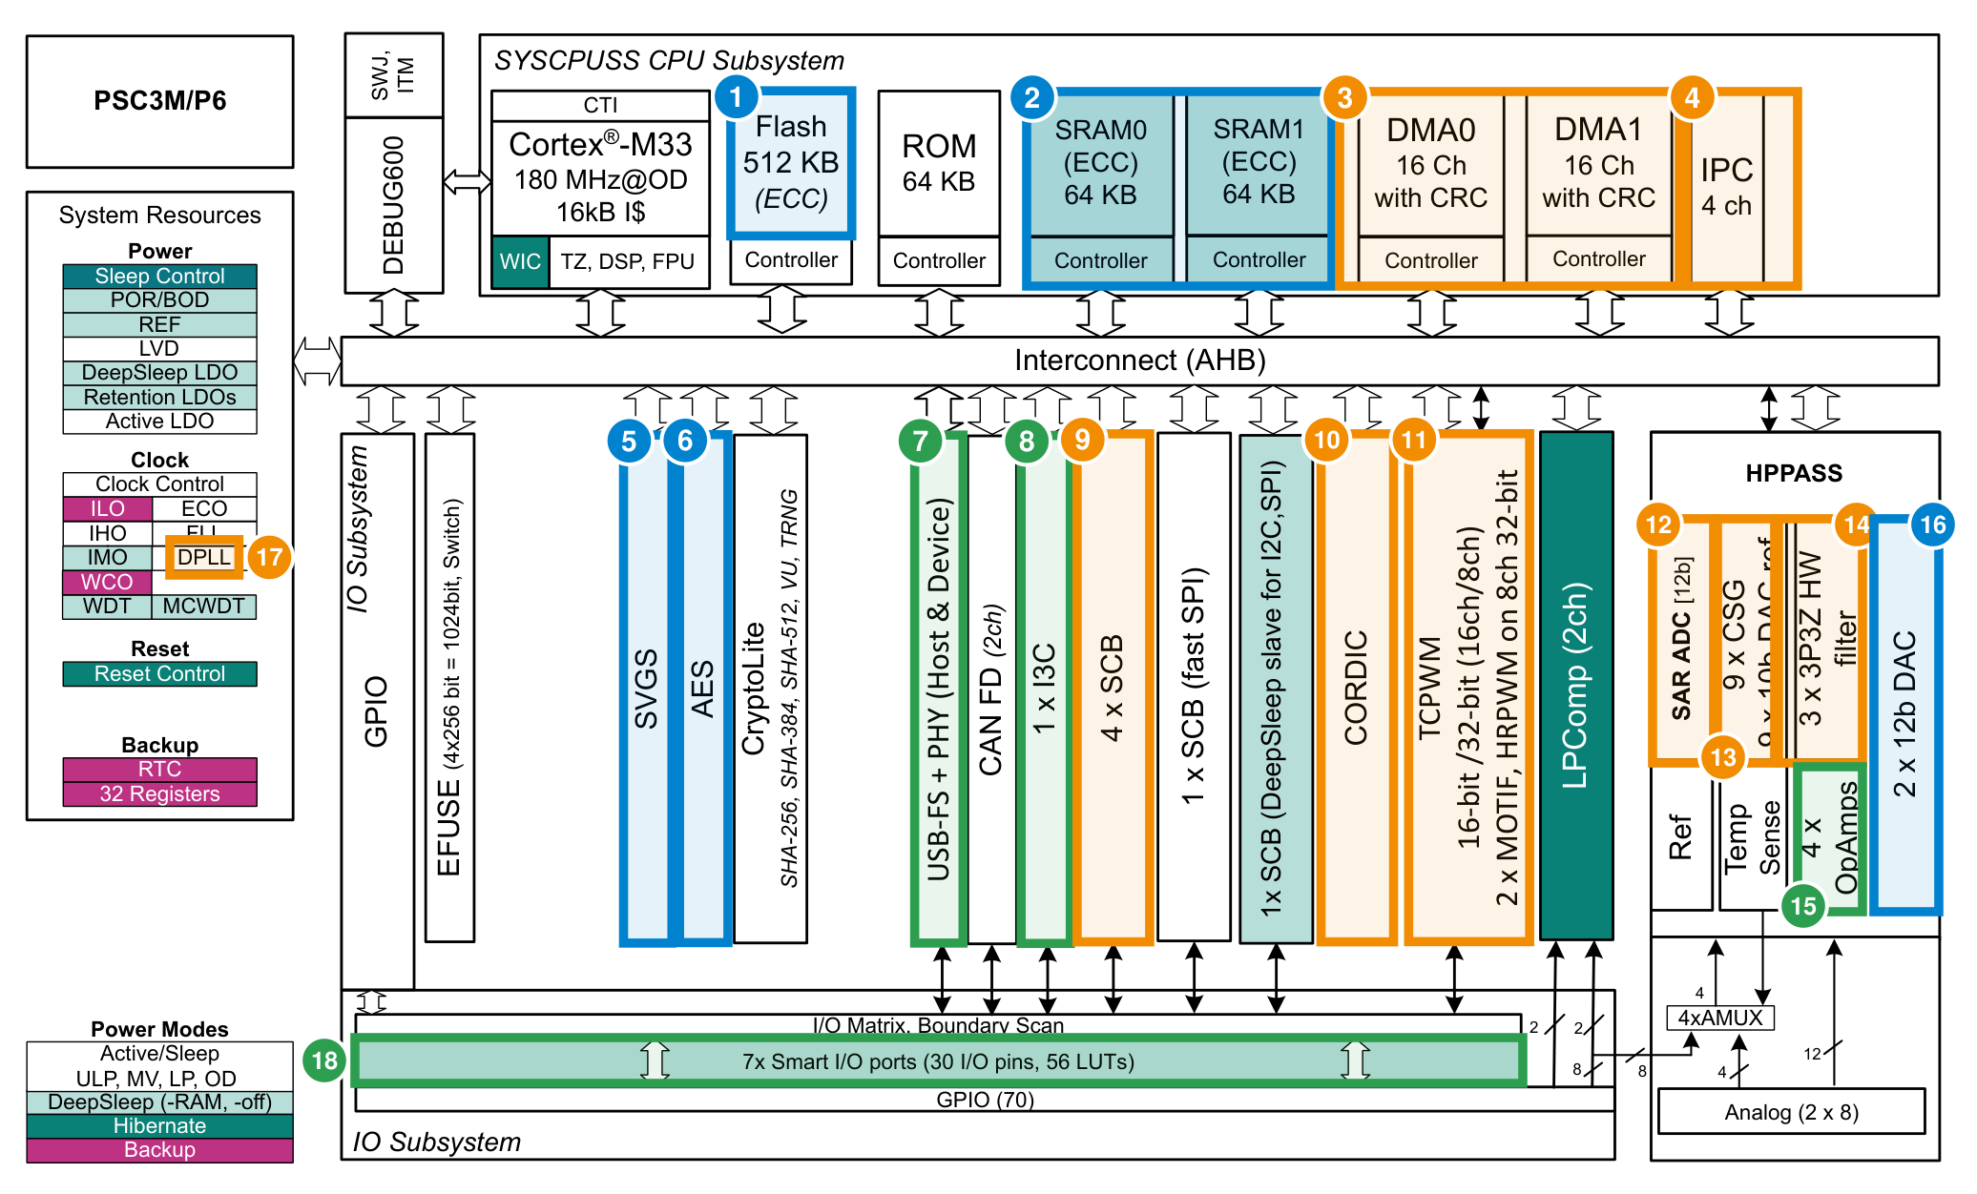
PSC3M6 functional block diagram - differences vs PSC3M8
Blue = same as PSC3M8, orange = differs, green = only on PSC3M6 (PSC3M8 has no PPCA equivalent of the red items)
1
Flash 512 KB - same as PSC3M8
2
SRAM 128 KB - same as PSC3M8 (PSC3M8 adds 112 KB PPCA SRAM)
3
2x DMA (16 ch) with CRC - PSC3M8 has ONE 16-ch DMA
4
IPC 4 ch - PSC3M8: 8 ch (+4 ch inside PPCA)
5
SVGS - same as PSC3M8
6
AES block - same as PSC3M8
7
USB-FS + PHY - not in PSC3M8
8
I3C - not in PSC3M8
9
6 SCB (PSC3M8: 7 SCB, 2 with PMBus)
10
1x standalone CORDIC (PSC3M8: 2x inside PPCA)
11
8x32 + 16x16 TCPWM, 2 MOTIF (PSC3M8: 12x32 + 14x16 in PPCA + 2x32 + 2x16)
12
1x SAR ADC 9 Msps (PSC3M8: 4x ADC 25 Msps in PPCA)
13
9 CSG, 10-bit DAC ref (PSC3M8: 9 differential DCSG, 12-bit DAC)
14
3x 3P3Z filter (PSC3M8: 6 channels in 2 HWFILT blocks, different datapath)
15
Up to 4 OpAmps - not in PSC3M8
16
2x 12-bit R2R DAC - same as PSC3M8
17
1 DPLL (PSC3M8: 2 DPLL)
18
Smart I/O 7 ports / 30 I/O - PSC3M8 has no Smart I/O
Source: PSC3M6 DS 002-42056 *C Fig.1 (p6); PSC3M8 DS 002-39793 *D Fig.1 (p6), p7-12.
Notes:
Same BOY2P picture, this time scored against BOY4. Memory, AES and SVGS are identical. HPPASS differs fundamentally: BOY4 does this inside the PPCA. BOY2P-only items: USB, I3C, OpAmps, Smart I/O.

Slide 21
I/O and packages
CHANGED PSC3M6 offers E-LQFP-64 / 80 / 100 only; PSC3M5 adds VQFN-40/48/64 and E-LQFP-48; PSC3M8 adds VQFN-48/64
NEW E-LQFP-100 (PSC3M5 has no 100-pin); 68 GPIO (M) / 70 (P) + 16 dedicated analog
CHANGED ADC channels: 24 on 80 / 100-pin, 19 on 64-pin (PSC3M5: 18 / 12)
NEW Up to 4 OVT GPIO (I3C OVT I/O); PSC3M8 has 6 GPIO_OVT, PSC3M5 none documented
CHANGED Smart I/O: 7 ports, 30 I/O (PSC3M5: 28); PSC3M8 none
CHANGED Analog-capable GPIO: 8 (PSC3M5: 2, PSC3M8: 14)
Pin names are not comparable across packages - compare function and port only; run a fresh pin-assignment before PCB reuse
GPIO @80-pin: 54 on every PSC3M6 OPN; 64-pin: 39. PSC3M8 per package: 60 / 45 / 33 (E-LQFP-64) / 34 (VQFN-64) / 25 (VQFN-48).
Sources: Ordering tables - PSC3M6 Table 65, PSC3M5 Table 29, PSC3M8 Tables 25-28; PSC3M6 DS p9, 26; TRM ch.24 (GPIO_OVT 24.3.2.1 new vs PSC3M5).
Notes:
Packages: the workbook says 'Smallest package E-LQFP-64 is BOY2P-unique' - factual but it is a drop of small-package options; call this out as a migration limitation for cost-sensitive BOY2 designs.

Slide 22
Migration checklist: PSC3M5 -> PSC3M6
What you gain
What to re-check
• 2x flash / SRAM: room for OTA, dual-bank bootloader, more RTOS
• Analog integration: OpAmps + DACs + 3P3Z remove external parts in current-sense and compensation
• 9 comparators, 8 HRPWM, 2 MOTIF: multi-axis / multi-phase designs on one chip
• I3C and USB-FS (100-pin M parts): sensors and PC / host connectivity
• Security: AES-256, SHA-384/512, PQC and DICE readiness, PSA L3 (512 KB), SVGS
• 70 GPIO / 100-pin option for higher I/O count
• Package: no VQFN / 48-pin; PSC3M5 pinout does not carry over - new PCB
• ADC: 12 -> 9 Msps (HPPASS 240 -> 180 MHz); re-time acquisition and sequencer
• HRPWM: 65 -> 87 ps typical steps (PSC3M6 at 180 MHz)
• Clocking: one DPLL - re-plan CPU / peri / USB clock sources
• Low-power wake: DeepSleep wake < 100 us (PSC3M5 < 20 us)
• Variants: choose OPN for USB, 3P3Z, 9 CSG, CORDIC / MOTIF (M vs P) - see matrix
• Software: flash driver, trigger tables, protection / provisioning flow
Sources: PSC3M6 / PSC3M5 datasheets and TRM.
Notes:
Frame the migration as a pull (more memory and analog) with four planning items: package, ADC timing, clocking, and variant selection.

Slide 23
Positioning: PSC3M6 next to PSC3M5 and PSC3M8
PSC3M5 (PSC3M/P5)
PSC3M6 (PSC3M/P6)
PSC3M8 (PSC3M/P7/8)
• Smaller memory: 256 KB / 64 KB
• Smallest packages: VQFN-40/48, E-LQFP-48
• 12-Msps ADC, 5 comparators, 4x 32-bit HRPWM
• PSA L2, no USB / I3C
• Choose for: designs that fit 256 KB / 64 KB and need small VQFN / 48-pin packages
• More memory and I/O: 512 KB / 128 KB, 70 GPIO
• Integrated analog: OpAmps, DACs, 3P3Z, 9 CSG
• I3C, USB-FS, AES, SVGS, PQC / DICE ready
• 8x 32-bit HRPWM, 2 MOTIF
• Choose for: integrated mid-range motor / power / connected designs with single-core control
• Performance line: PPCA 2x M33 @200 MHz
• 4x 25-Msps ADC, 9 differential DCSG, EPU, CLB
• 26 TCPWM channels incl. 12 HRPWM in PPCA
• No Smart I/O, I3C, USB or OpAmp
• Choose for: high-switching-frequency digital power (DS: up to 2 MHz), GaN / SiC, multi-core control
Positioning derived from datasheet feature lists and target-application statements (PSC3M8 DS p1: 'switching frequencies up to 2 MHz'). Thresholds are guidance, not guarantees.
Notes:
Selection guide: BOY2P sits between BOY2 and BOY4. Position it as the integration step-up from BOY2 (analog + connectivity + security) rather than a BOY4 replacement.

Slide 24
Anticipated customer questions
Question | Answer (source-backed)
Can PSC3M6 replace a PSC3M8 design? | Only if the loop runs on one 180 MHz core: no PPCA, EPU, CLB, 4x25-Msps ADC. See feature mapping.
Is the HRPWM better than PSC3M5? | No - 86.8 ps typ. at 180 MHz vs 65.1 ps at 240 MHz on PSC3M5; PSC3M6 adds more counters (8 vs 4).
Do all PSC3M6 parts have USB / 3P3Z / CORDIC? | No: USB only on 100-pin M parts; 3P3Z absent on 256 KB M parts; CORDIC / MOTIF only on M parts.
Why only one DPLL? | Documented: DPLL#0 (25-240 MHz) only; FLL + fixed IHO / ECO paths cover the other root clocks.
Is PSA L3 certified? | Datasheet: 'PSA L3 ready'; capable only on 512 KB flash variants. Do not quote a certificate.
Does DMA / CAN FD / WDT code port? | Yes - register sets identical across PSC3M5, PSC3M6 and PSC3M8 (TRM chapter diff).
Does PSC3M8 have Smart I/O or OpAmps? | No - neither appears in PSC3M8 documents. Smart I/O is on PSC3M5 and PSC3M6; OpAmps only on PSC3M6.
Is deep-sleep wake the same? | No: < 100 us on PSC3M6 vs < 20 us on PSC3M5 / PSC3M8 (datasheet Table 1).
Sources: PSC3M6 / PSC3M5 / PSC3M8 datasheets (Tables 1, 33/19/16, ordering tables); architecture chapter diff.
Notes:
Use these as a Q&A cheat-sheet. Each answer corresponds to a verified statement in this deck.

Slide 25
ModusToolbox™ Ecosystem
HandsON-Get started with PSC3M6_EVAL

Slide 26

ModusToolbox™ – Development ecosystem
ModusToolbox™ Software is a modern, extensible development ecosystem supporting a wide range of Infineon microcontroller devices.
Provided as collection of development tools, libraries, and embedded runtime assets architected to provide a flexible and comprehensive development experience.
Development Tools
Run-Time Software
The ModusToolbox™ tools package includes desktop programs that enable the creation of new embedded applications, managing software components, configuring device peripherals and middleware, and embedded development tools for compiling, programming, and debugging.
The ModusToolbox™ software includes an extensive collection of GitHub-hosted repositories comprised of code examples, board support packages, middleware, and application support.
Notes:
ModusToolbox™ Software is a modern, extensible development environment supporting a wide range of Infineon microcontroller devices.
ModusToolbox™ is more than a singular Integrated Development Environment (IDE) or SDK delivery mechanism. There are two main parts to ModusToolbox™ that work together to achieve an effective embedded ecosystem. These primary parts are the desktop applications or development tools and the embedded run-time software assets.
Development tools, supporting Windows, Linux, and macOS, are available as a tools installation package from the Infineon Developer Center. These desktop applications enable the creation of new embedded applications, managing software components, configuring device peripherals and middleware, and embedded development tools for compiling, programming, and debugging. The ModusToolbox™ development tools interface directly with the available run-time software repositories, providing easy access to the latest development resources.
Run-time software comprised of middleware, board support packages, device drivers, and code examples is provided via an extensive collection of GitHub-hosted repositories. GitHub repositories allow Infineon and partners to rapidly respond to and distribute updated code releases.

Slide 27
ModusToolbox™ – Comprehensive collection of resources
Project
Creator
Library
Manager
Eclipse and partner IDEs
Configurators and Tuners
Git and Make build system
Enablement throughout the application development process
Tools
IDEs – VS Code / Eclipse / IAR / Arm Keil
  Dedicated User Guides for working with respective IDEs (see hyperlinks above)
Configurators and Code Generation
  Device Configuration (Pins / Clocks)
  CAPSENSE Configuration and Tuning
Additional ModusToolbox™ Packages
  Programming Tools
  Edge Protect Security Suite
  Motor Suite / Power Conversion
Application Development Resources
Middleware from Infineon and the ecosystem
Board Support Packages / Device Packages
App
Code Examples
Use Case Demos
Reference Solutions
RTOS
Graphics
CAPSENSE™
Security
Middleware
Voice / Audio
Machine Learning
Wi-Fi
Bluetooth®
BSP
Microcontrollers
USB Power Delivery Devices
Connected
MCUs (Wi-Fi)
Bluetooth® Devices
ModusToolbox™ Community
API
Documentation
GitHub
Repositories
Notes:
ModusToolbox provides a comprehensive collection of resources to enable development of embedded applications.
IDEs – ModusToolbox works out of the box with industry leading IDEs, including Microsoft VS Code, IAR Embedded Workbench, Arm MDK with Keil uVision IDE, or an Eclipse IDE available in ModusToolbox Setup.
Configurators – Graphical applications that support device initialization and generated for configuration parameters.
BSP-level configurators generate code and data structures that are specific to the hardware and the implementation of the physical connections to the device.
BSPs - These resources include board support packages (BSPs) that encompass device support for the wide range of supported microcontrollers, programmable power delivery controllers, Wi-Fi devices, and Bluetooth® SoCs. In additional to the device level support, these BSP targets provide a starting reference for development kits from Infineon and partners supporting ModusToolbox.
Middleware - The next resource available within the ModusToolbox ecosystem are the middleware repositories including, but not limited to: Human-Machine Interface, Graphics, Connectivity, Security, Voice / Audio, Machine Learning, Wi-Fi, and Bluetooth.
Apps - Code examples and reference applications complete the list of available ModusToolbox resources, providing projects ranging from simple peripheral use case examples to complex connectivity references that can be used as starting points for application development.
Documentation for middleware and driver APIs are readily available and accessible directly with the IDE application.
Training modules and How-To Videos – provide self-paced content to understanding ModusToolbox concepts and getting started with fundamental code exercises.

Slide 28
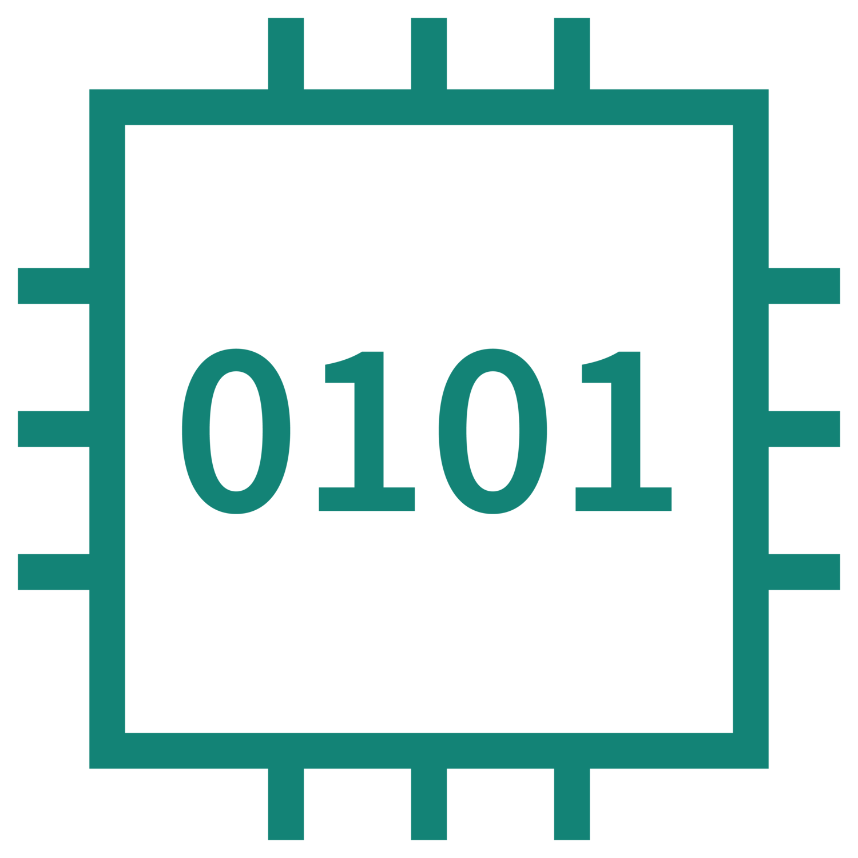




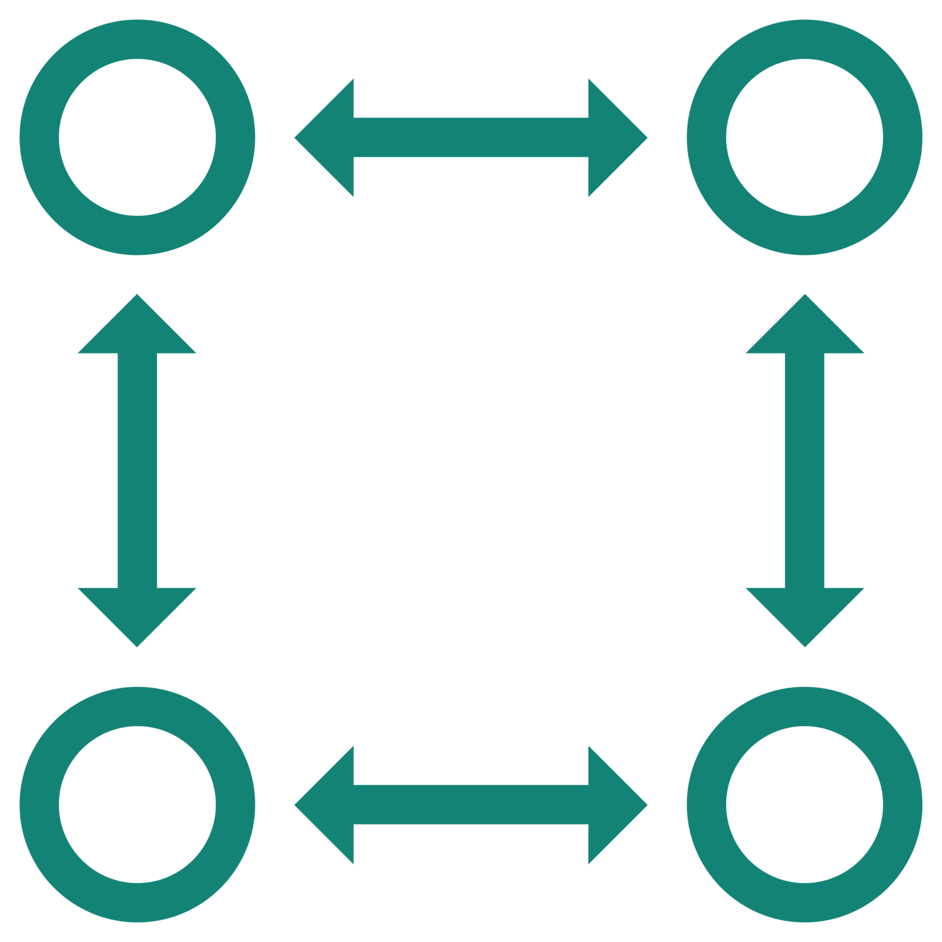

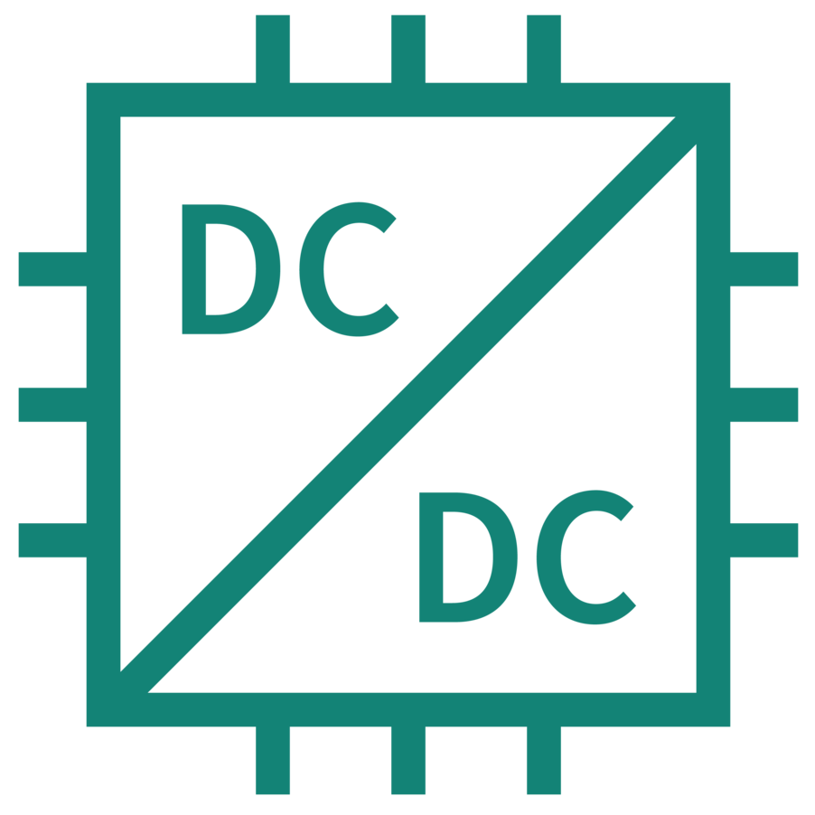






ModusToolbox™ Ecosystem Overview
Programming Tools
ModusToolbox™
Dashboard
Edit
Compile
IDE
Library Level
Configuration
Programming GUI
KitProg Firmware / OpenOCD
Documentation
Microsoft Visual Studio Code
Eclipse IDE for ModusToolbox™
IAR Embedded Workbench
Arm MDK µVision
Machine Learning
Bluetooth®
USB / USB Power Delivery
Motor Suite
BSP Assistant
Debug
Graphical Motor Tuning and Configuration
Project Creator
Power Suite
Run-Time Software Repositories:
BSPs, Middleware Libraries, Code Examples
Power Conversion Configuration and Code Gen
BSP Level Configurators
Library Manager
Device Configurator
CAPSENSE™ Configurator
QSPI Configurator
Smart I/O Configurator
Select or Import BSP
Add Middleware
Manage Middleware versions
Edge Protect Security Suite
Edge Protect Tools and TM-F Configuration
DEEPCRAFT™
ModusToolbox™
Setup
Online installation of ModusToolbox™ base installation, toolchain, IDE, and additional packages
Studio, Model Converter, AI Hub, Audio Pack

Slide 29


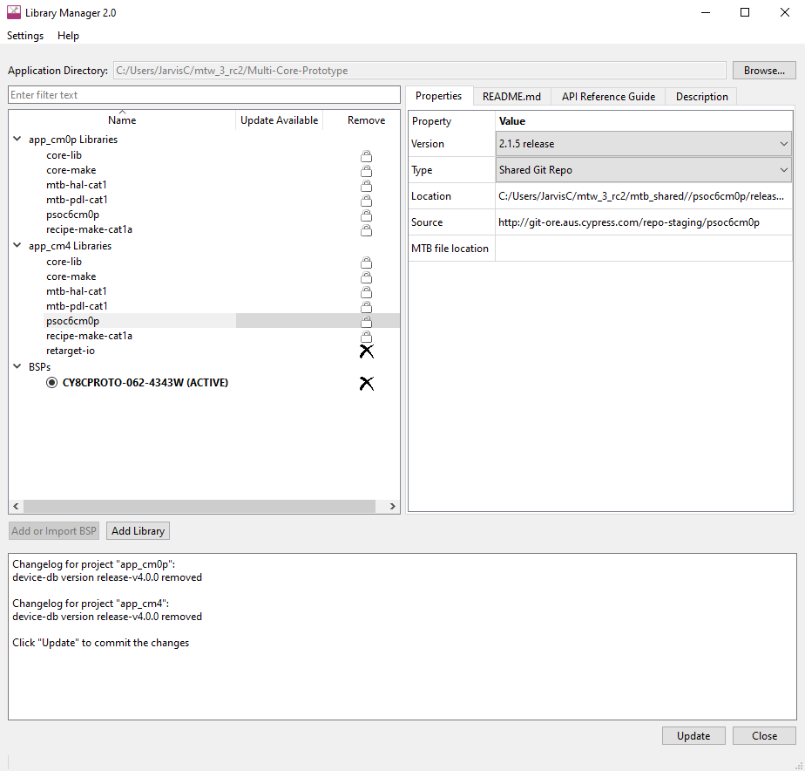

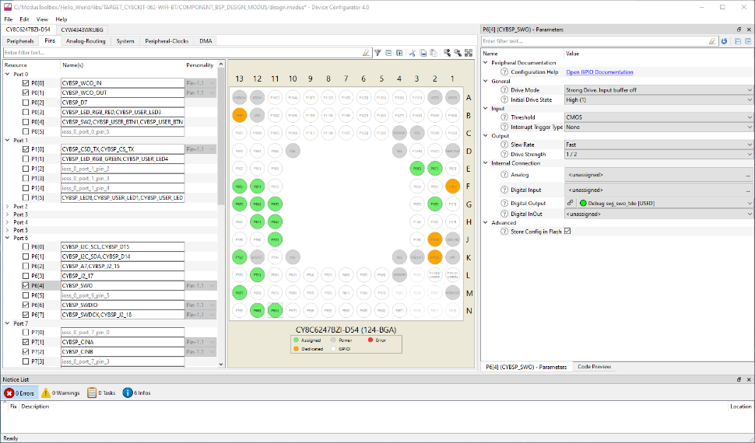

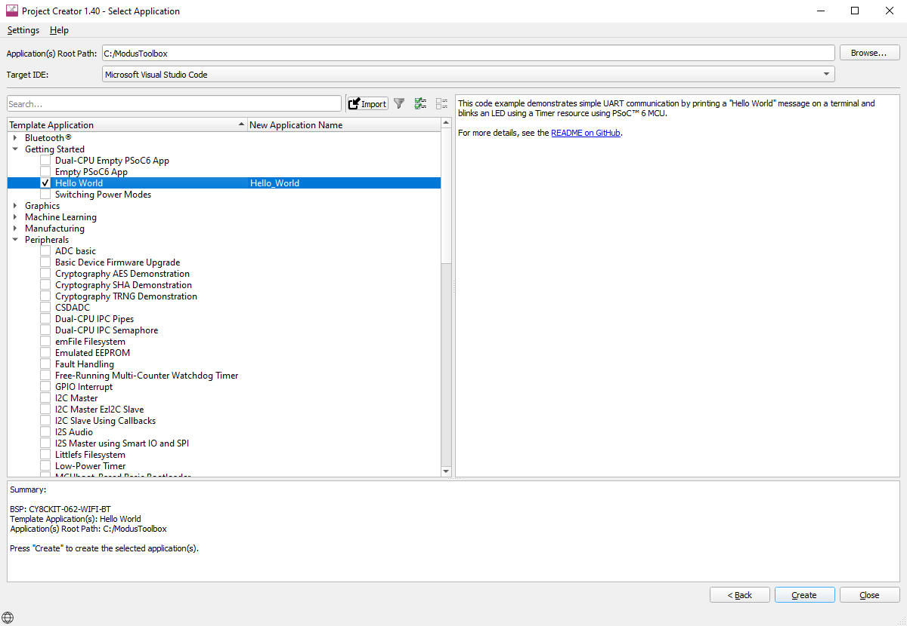
ModusToolbox™ Software – Development Workflow
Configurators, Tuners, and Utilities
Project Creator
Library Manager
Device Configurator
BSP Assistant
Secure Policy Configurator
CAPSENSE™ Configurator and Tuner
BSP level configurators for QSPI, SmartIO, SegLCD
Library level configurators for Machine Learning, USB, USB-PD, Bluetooth®, LIN
… and more

Slide 30
ModusToolbox™ – List of supported MCU devices
PSOC™ Control
PSC1M2
PSC1M3
PSC3M3
PSC3M5
PSC3M6
PSC3M7
PSC3M8
PSC3P2
PSC3P5
PSC3P6
PSC3P7
PSC3P8
PSOC™ 4
PSOC 4 HVPA-SPM 1.0
PSOC 4100T Plus
PSOC 4100T Plus 256KB
PSOC 4 HV MS 128k
PSOC 4 HV MS 64k
PSOC 4 HV PA 144k
PSOC 4000S
PSOC 4000T
PSOC 4100S
PSOC 4100S Max
PSOC 4100S Plus
PSOC 4500H
PSOC 4500S
PSOC 4700S
XMC™
XMC1100
XMC1200
XMC1300
XMC1400
XMC4100
XMC4200
XMC4300
XMC4400
XMC4500
XMC4700
XMC4800
XMC5100
XMC5200
XMC5300
XMC7100
XMC7200
TRAVEO™
CYT2B6
CYT2B7
CYT2B9
CYT2BL
CYT3BB
CYT3DL
CYT4BB
CYT4BF
CYT4DN
CYT6BJ
USB
FX2G3
FX3G2
AIROC™ Bluetooth®
20706
20707
20719
20721
20735
20736
20737
20819
20820
20829
20835
30739
89829
AIROC™ Connectivity
43012
43022
43438
43439
4343W
4373
4373E
4390x
55310
55512
55513
55533
55570
55571
55572
55573
55913
CCG
CCG6DF_CFP
CCG7D
CCG7S
CCG8
CCG8DF_CFP
PAG2S
Wireless Charging
WLC1
PMG
PMG1B1
PMG1S0
PMG1S1
PMG1S2
PMG1S3
PSOC™ Edge
PSE8x2
PSE8x3
PSE8x5
PSE8x6
PSE8xxGO
PSE8xxGP
PSOC™ 6
PSOC 61
PSOC 62
PSOC 63
PSOC 64
New devices are regularly added to ModusToolbox™, review to the latest release notes for details
Additional device support may be enabled via Early Access Packs – accessible through controlled IDC downloads
Notes:
List of Infineon product families that are currently supported in ModusToolbox. Devices are regularly added to ModusToolbox, please refer to the latest Release Notes or the ModusToolbox application directly to see the most out to date content.

Slide 31
What is a ModusToolbox™ BSP?
Your Application Code
The BSP answers three questions:
  Which chip — device ID, core type, flash/RAM sizes
  How is it wired — pin assignments, crystal frequencies, debug interface
  How does it boot — startup code, linker scripts, memory map
Portable across boards
Middleware / Peripheral Drivers
Device-family API layer
Board Support Package
Pins, clocks, memory, startup
Silicon (MCU)
PSOC™ Control, PSOC™ Edge, etc…

Slide 32

PSOC Developer Journey- Live demo https://www.infineon.com/psocdeveloper/discover

Slide 33
Lab1:
GitHub Hello World – hands-on walkthrough
Step 1: Install ModusToolbox™ 3.x; connect a PSC3M5 / PSC3M6 kit via KitProg3/JLink
Step 2: Launch 'New Application from Template'
  Select BSP: KIT_PSC3M5_EVK or KIT_PSC3M6_EVAL
  Select template: Hello World (GPIO toggle + retarget printf via UART)
Step 3: Review the project layout
  main.c, bsps/, deps/, libs/, Makefile, GeneratedSource/
Step 4: Build the Debug configuration, then program the target with KitProg3
Step 5: Open the built-in terminal at 115200 8N1; confirm the Hello World message and LED
Step 6: Change the blink rate, then save, build, program, and confirm the result

Slide 34
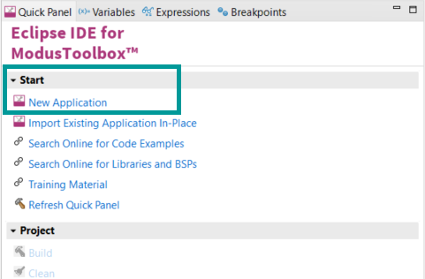
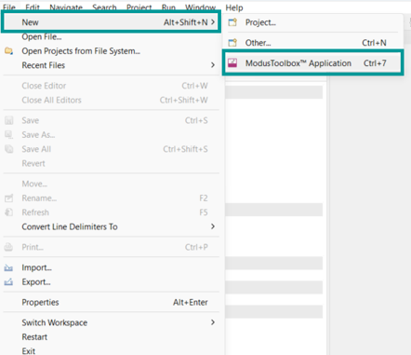
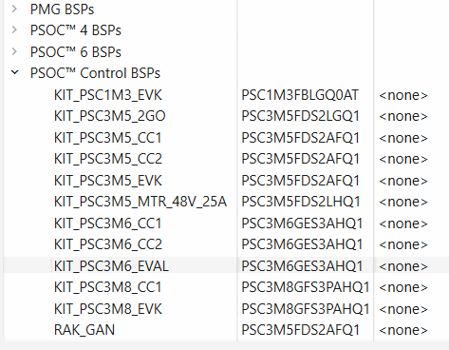
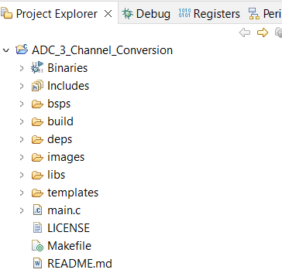
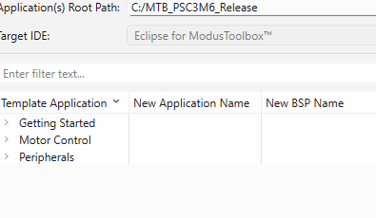
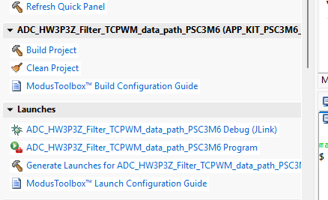
Lab1: working with Modustoolbox and PSC3M6_EVK
How to import MTB based code example
Steps:
Create a new ModusToolbox™ application
  From the Quick Panel, Click on Start, and then click New Application.
  Alternatively, you can choose File > New > ModusToolbox™ Application.
Select a target PSOC™ development kit, in the Choose Board Support Package (BSP) dialog, choose the Kit Name, choose KIT_PSC3M6_EVAL, Click Next
Select desire code example/ Hello World - CE under Template application and click create
Project structure been added to the workspace
Build and Flash the code to the Kit via Jlink
1
b
a
2
4
3
5

Slide 35
Session:
Architecture Deep Dive – Core System

Slide 36
Cortex®-M33 CPU sub-system
Arm® Cortex®-M33 v8-M mainline core running up to 180 MHz
  DSP extension: MAC + SIMD instructions for filters / control loops
  Single-precision FPU (VFPv5) for floating-point algorithms
  Memory Protection Unit (MPU): 8 regions + sub-region masks
  TrustZone®: secure / non-secure state with SAU + IDAU
16 KB instruction cache: 0 wait states on hot code
Wake-up Interrupt Controller (WIC) for Sleep / Deep-Sleep restart
NVIC: vectored interrupts with priority and preemption
4 × Inter-Processor Communication (IPC) channels between secure/non-secure
Debug + trace: SWJ-DP + ETM(4bit) / DEBUG600 + CTI + ITM (8bit)

Slide 37
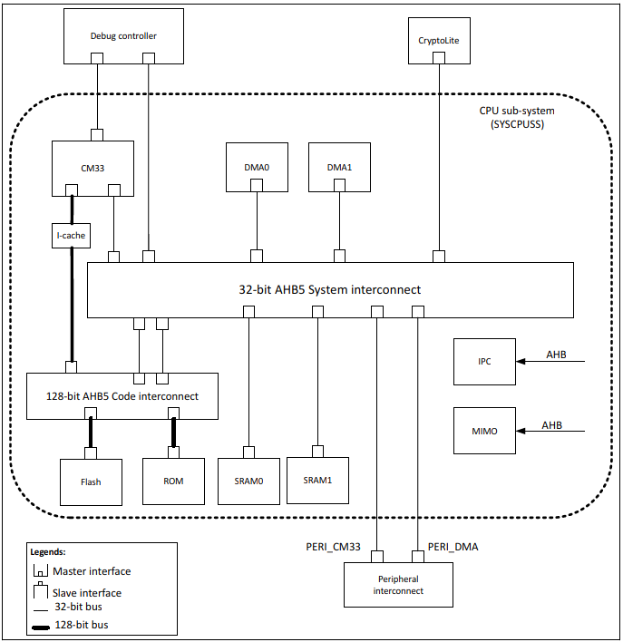
Bus infrastructure and system interconnect
Multi-master 32-bit AHB matrix
Masters:
  Cortex® -M33 code AHB (C-AHB) bus via instruction cache (I-cache)
  Cortex® -M33 slave AHB (S-AHB) bus
  Two direct memory access – Datawire (DMA0, DMA1)
  One cryptographic accelerator (CryptoLite)
Slave sub-systems
  Flash controller (128-bit R-bus)
  SRAM controllers (ECC-checked)
  MMIO group (SCB, CAN FD, TCPWM, USB, I3C)
  CM33 to Peripheral interconnect( PERI_CM33)
  HPPASS analog cluster
  IPC + shared registers
Deterministic access latency supports real-time control loops
PPCs enforce master-based peripheral access rules

Slide 38
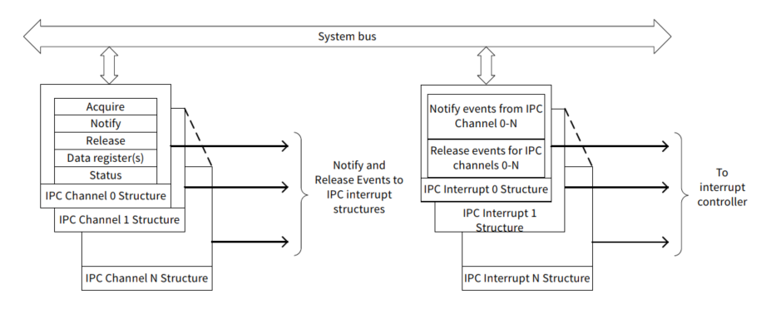
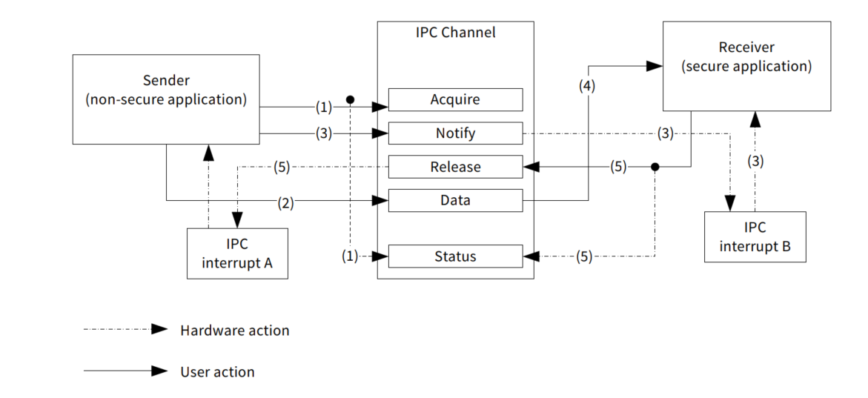
Inter Process communication ( IPC)
Inter-processor communication (IPC) provides the functionality for secure applications and non-secure applications
IPC hardware is implemented using two register structures.
IPC Channel upto 4: Communication and synchronization between processors
IPC Interrupt upto 2: which can be triggered by a ‘notify’ or ‘release’ event of any IPC channel
PC channels can be used to communicate messages between secure and non-secure applications.
In this use case, the channel is used in conjunction with the interrupt structures.
  The IPC channel is used to lock access to the data registers.
  The IPC channel is acquired by the sender and used to populate the message.
  The receiver reads the message and then releases the channel. Thus, between the sender transmitting data into the channel and the receiver reading it, the channel is locked for all other task access

Slide 39
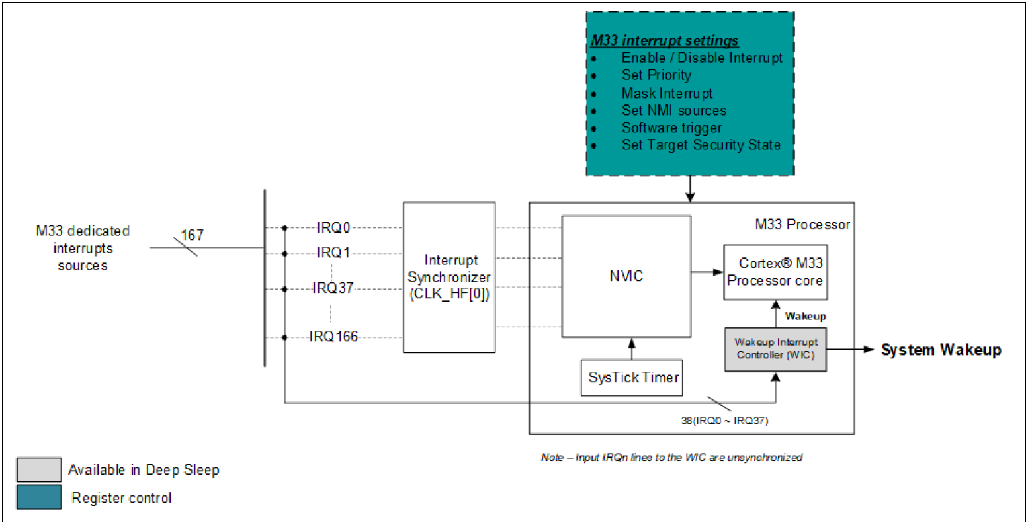
Interrupt architecture
Cortex®-M33 NVIC + WIC
Support 167(140 in M5) system interrupts
Priority levels and preemption per source
The Wake-Up Interrupt Controller keeps the IRQ path active in Deep Sleep
38 wake up source from DS mode( 30 in M5)
Vector table can live in flash, SRAM or Sflash
Seperate vector tables for M33 secure and non secure states
Fault reporter aggregates ECC / MPU / bus faults
Configurable fault → NMI / reset routing
Level triggered interrupt signals
Design tip
  Use PPC + SAU to isolate secure ISRs at the fabric level

Slide 40
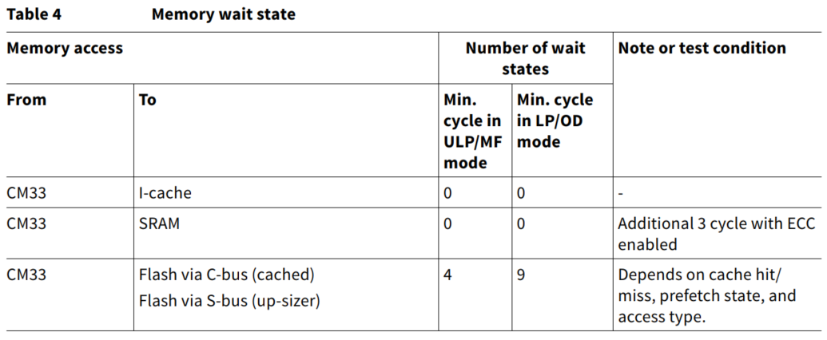
Memory hierarchy and access latency
Program flash
  256 KB (M5) / up to 512 KB (M6) with ECC + Read-While-Write
  128-bit read word + 9-bit ECC per word
  Read-While-Write enables live firmware update during operation
  Dual-bank mode: swap Main ↔ Alternate for firmware upgrade
SRAM
  64 KB (M5) / up to 128 KB (M6) with ECC (soft-error detection + correction)
  Deep-Sleep retention granularity 64 KB per SRAM controller
ROM (64 KB) + SFlash (32 KB)
  Boot code, factory routines, provisioning, calibration data
I-cache: 16 KB, transparent to firmware – 0 wait states on hot loops( subsequent execution of cached instructions)
Access latency budget: DMA + HPPASS overlap with CPU via AHB matrix( synchronous Bus clocks between CPU and peripherals)

Slide 41
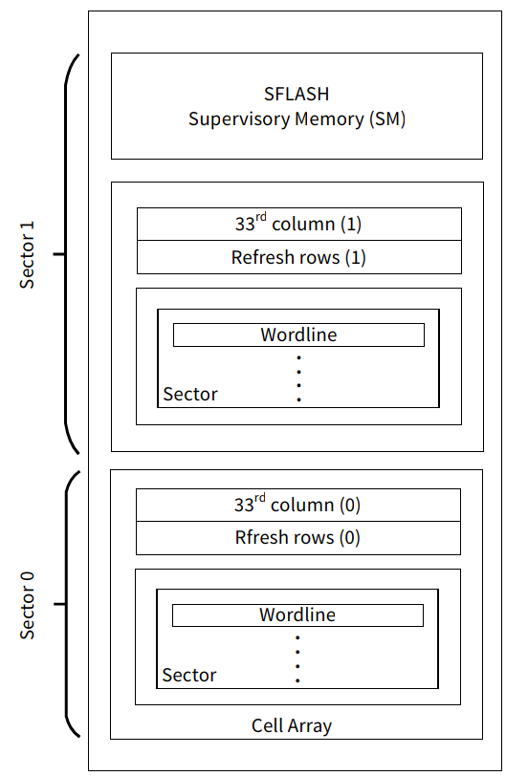
Flash geometry – sectors, wordlines and refresh
Sector 0 = Main flash, Sector 1 = SFlash (SM)
Sector size: PSC3M6-256 KB (512 rows × 512 bytes)
Wordline (row): 512 bytes
  Composed of 32 units of 128-bit read words( 4096 bits)
  Each read word: 128 data bits + 9 ECC bits
33rd column + refresh rows manage cell reliability- it seves as a counter to track the aging of rows during erase/Program
A wordline is the smallest programmable or erasable unit
Cell array feeds the 128-bit R-bus
Refresh is needed when the flash is written >100K times
FM controller support read while write operation on the same flash using dual flash bank concept .
Endurance calucaltion example
  Wordline: 512 bytes
  Em_EEPROM data =16byte data ( min 1 byte read/write)
  512/16=32 updates that one wordline can hold
  32x flash endurance
  32x100K = 3.2 million logical updates

Slide 42
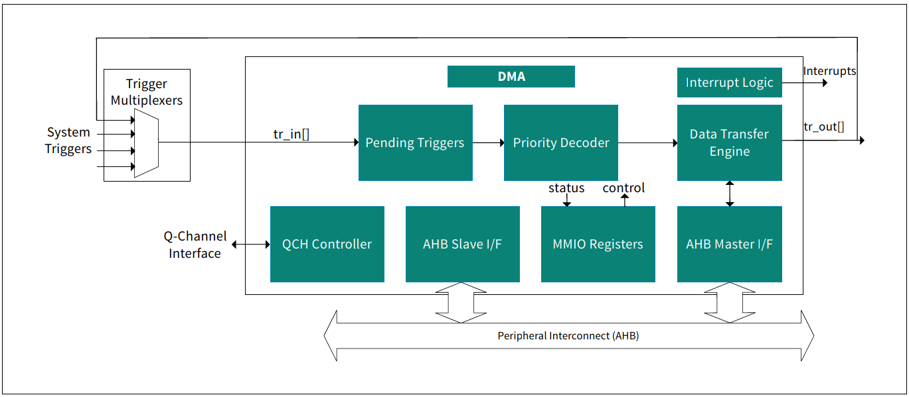
DMA architecture – 2 × 16-channel controllers
Two DMA controllers, 16 channels each
Descriptor-driven: 1D / 2D / scatter-gather( chain multi-descriptor) / CRC transfers
Trigger sources routed via TriggerMux
4 priority levels with round-robin arbitration
Configurable CRC per channel (CRC-32 / 16 / 16-CCITT)
Typical uses
  ADC result → SRAM ring buffer / 3P3Z
  SCB TX/RX streaming, CAN FD message transfer
  Memory-to-memory bulk copies

Slide 43
DMA descriptor types – picking the right one
Single transfer
  One 8 / 16 / 32-bit element, 14 clocks
  Move a single ADC sample to a register
1D transfer
  Simple for-loop transfer: 12 + n·3 + m cycles
  Fill a buffer from a peripheral FIFO
2D transfer
  Nested for-loop transfer: 13 + n·3 + m cycles
  Rasterise sensor data or interleave multi-channel ADC
CRC descriptor
  Compute CRC over a region: 17 + n·9 + m cycles
Descriptor chaining: build circular buffers or state machines
m = total wait states , n=data elements

Slide 44
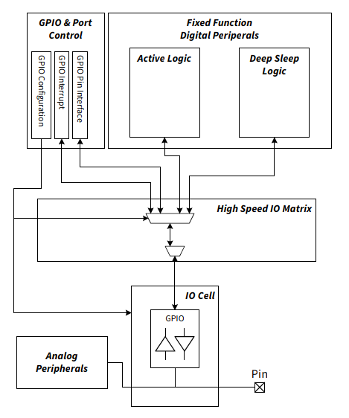
GPIO cell architecture
Every pin: input buffer + output driver + drive-mode logic
Drive modes
  Analog, HiZ, Pull-up, Pull-down, Strong, Open-drain, HiZ analog
Programmable drive strength and slew rate
Analog-capable GPIOs feed HPPASS: 2 (M5) / 8 (M6)
1xI3C interface with over voltage tolerant ( OVT) I/O (M6)
Upto 4 over-voltage tolerant(OVT) pins (M6)
Hibernate wake-capable pins: P2.0 and P9.0
Interrupt options: rising / falling / either / level
Configured centrally in MTB Device Configurator

Slide 45
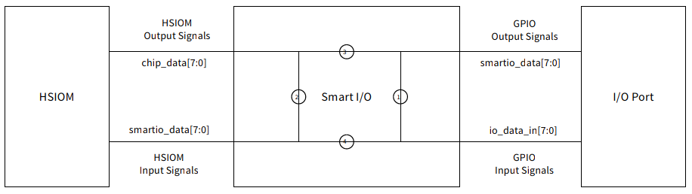
Smart I/O – programmable Boolean glue logic
Up to 7 Smart I/O ports, 56 LUTs total
Apply Boolean logic to I/O signals with no CPU load
Combine, invert, AND, OR, or gate multiple TCPWM outputs
Route peripheral signals to any pin within a port
Smart I/O pins: up to 28 (M5) / 30 (M6)
Operates in Deep Sleep as autonomous glue logic
Typical uses
  Dead-time + kill gating around motor bridges
  PWM inversion for driver polarity
  External sync signal generation

Slide 46
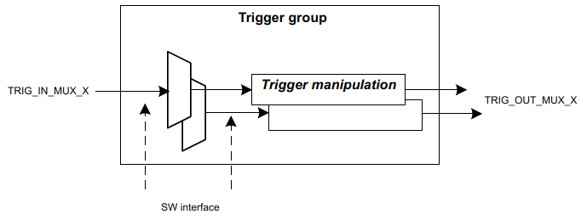
TriggerMux – deterministic peripheral chaining
Combinatorial trigger fabric between
  HPPASS ↔ TCPWM ↔ DMA ↔ CPU ↔ CryptoLite
Three trigger group types
  1-to-1: fixed direct routes (fastest, dedicated)
  Multiplexer: any source to any destination
  Group: broadcast a source to multiple destinations
Level or pulse; edge shaping and inversion
<1 ns latency HPPASS ↔ TCPWM kill path
Enables autonomous ADC → PWM update loops

Slide 47
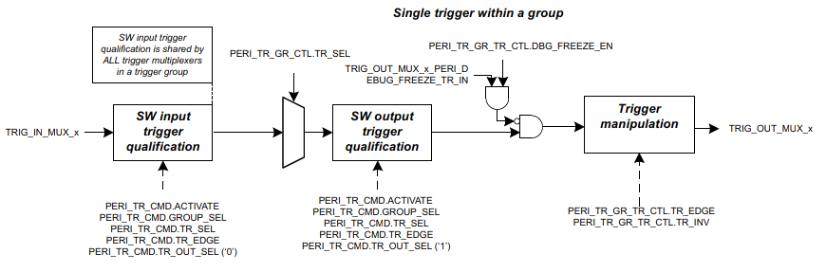
TriggerMux multiplexer trigger group
Example-PERI Trigger source group 0 (PDMA0 Trigger MUX)
Multiplexer group example: any of 128(M5) or 194(M6) sources to any of 16 destinations
Same source can go to many destinations via multiple muxes
Each destination has exactly one active source at a time
Trigger manipulation stage
  Asynchronous edge detection
  Synchronise across peripheral clock domains
  Level inversion
Configured centrally via MTB Trigger MUX configurator

Slide 48
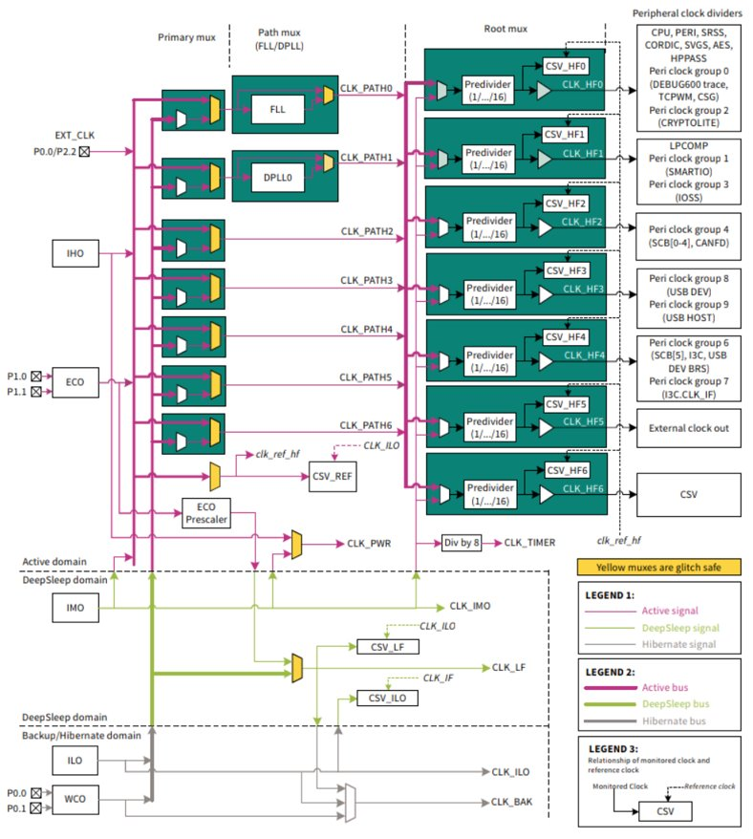
Clocking system architecture
Oscillators
  IMO 8 MHz ±2 %: Deep-Sleep capable
  IHO 48 MHz ±1 %
  ILO 32 kHz ±10 %
  ECO 4–35 MHz, WCO 32.768 kHz
  External clock up to 80 MHz on P0.0 or P2.2
PLL / FLL
  FLL 24–100 MHz
  DPLL 25–250 MHz: 2 × on M5 and 25-180Mhz : 1 × on M6
Seven clock paths, seven high-frequency root clocks (CLK_HF0…6)
Configured in Device Configurator (visual)

Slide 49
Clock distribution and Active mode performance parameters
The details of the CLK_HF distribution network and the maximum CPU and peripheral frequencies for the different Active modes are shown in the table below:
CLK_HF | Peripherals | Source | Max permitted clock frequency¹
 |  |  | OD (1.2 V) | LP (1.1 V) | MF (1.0 V) | ULP (0.9 V)
CLK_HF0 | CPU, PERI, SRSS, CORDIC, DEBUG600, SVGS, AES, HPPASS², peri clock group 0 (TCPWM, CSG), peri clock group 2 (CRYPTOLITE) | IMO, IHO, DPLL0, FLL | 180 MHz | 150 MHz | 70 MHz | 50 MHz
CLK_HF1 | LPCOMP, peri clock group 1 (SMARTIO), peri clock group 3 (IOSS) | IHO, DPLL0, FLL | 180 MHz | 150 MHz | 70 MHz | 50 MHz
CLK_HF2 | Peri clock group 4 (CAN, SCB[0:4]) | IHO, FLL | 100 MHz | 100 MHz | 25 MHz | 25 MHz
CLK_HF3 | Peri clock group 8 (USB DEV), peri clock group 9 (USB HOST) | ECO, FLL | 50 MHz | 50 MHz | 50 MHz | 50 MHz
CLK_HF4 | Peri clock group 6 (SCB[5], I3C, USB), peri clock group 7 (I3C.CLK_IF) | IHO, DPLL0 | 180 MHz | 150 MHz | 70 MHz | 50 MHz
CLK_HF5 | EXT_CLK_OUT | IHO, DPLL0 | 80 MHz | 80 MHz | 80 MHz | 50 MHz
CLK_HF6 | CSV | IMO | 8 MHz | 8 MHz | 8 MHz | 8 MHz
¹ Maximum clock frequency after the corresponding clock source (DPLL / FLL + dividers). All internal tolerances and effects are covered by these frequencies.
² The minimum permitted clock frequency of HPPASS is 60 MHz.
Notes:
This slide provides a view of the clock distribution network and the corresponding performance limits.
When configuring clocks, it is important to ensure that both the CPU and peripherals operate within their specified maximum frequencies.
The clock tree should always be evaluated together with the performance specifications shown in the datasheet.

Slide 50
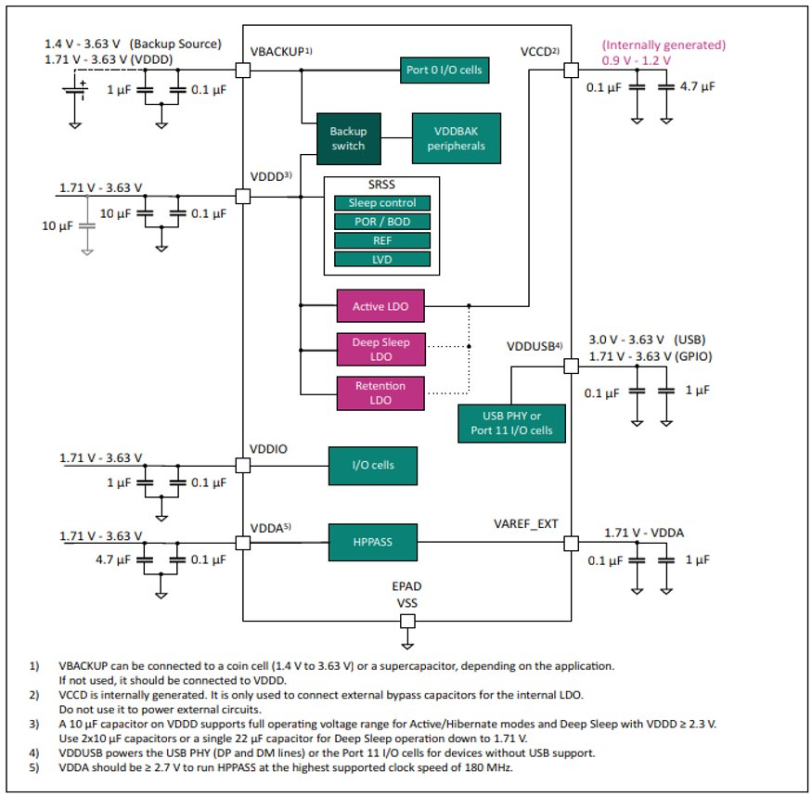
Power supply and monitoring
Single regulated VDDD 1.71–3.6 / 3.63 V
Multiple VDDIO domains for I/O flexibility
VBACKUP 1.4–3.6 V for RTC, WCO, ILO, backup regs
Core LDO regulates 0.9 / 1.0 / 1.1 / 1.2 V
Active, Deep-Sleep, Retention LDOs plus dedicated analog LDO
POR / BOD / LVD continuous supervision
SVGS: Supply-Voltage Glitch Sensor (M6 only)

Slide 51
Supply Voltage Glitch Sensor (SVGS)-M6 only
The SVGS module provides a robust and reliable way to monitor the supply voltage and detect any potential glitches or attacks
The block implements high-speed comparators that supervise the microcontroller’s core supply (VCCD) and provide protection against disturbances on operational supply (VDDD)
SVGS module consiits of four comparators –
  UVC (Under-Voltage Comparison) function detects undershoot events of VCCD
  OVC (Over-Voltage Comparison) function detects overshoot events of VCCD
  NVC (Noise Voltage Comparison) function compares noise amplitudes of VCCD with respect to its defined noise threshold
  UVFC (Under-Voltage Comparison with Filtered supply) function detects undershoot events of filteredVCCD
SVGS
UVC
OVC
NVC
UVFC
SVGS detects very short supply voltages disturbances that are too fast for traditional brownout detectors

Slide 52
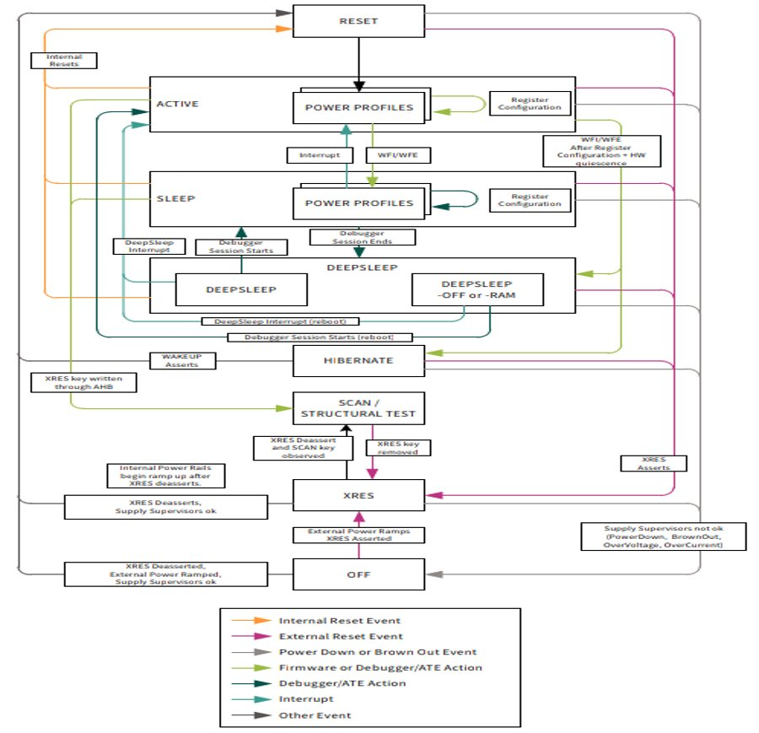
Power modes and transitions
6 modes: Active / Sleep / Deep Sleep / DS-RAM / DS-OFF / Hibernate
Active profiles ULP / MF / LP / OD (0.9–1.2 V core)
  50 / 70 / 150 / 180 MHz CPU respectively
Deep-Sleep wake latency <45 µs
Hibernate current <1 µA with RTC + LPComp
Wake sources: any IRQ / DS peripherals / RTC / hibernate wake pins
SRAM retention granularity 64 KB per controller
Hibernate wake only via P2.0 / P9.0 and LPComp

Slide 53
Lab2:
Demo – measured core-system latency chain
Set-up on evaluation kit
  Use the Hello world code with PSC3M6_EVK
  Replace the main.c file content as provided
  Compile and build the code
  Simple direct register ( no PDL call) write-read back timing test
  Using 10 TCPWM register to write and read back
  Registers used: CC0, CC0_BUFF, CC1, CC1_BUFF, PERIOD_BUFF, LINE_SEL, LINE_SEL_BUFF, TR_IN_SEL0, TR_IN_SEL1, TR_IN_EDGE_SEL - all on TCPWM0 GRP0_CNT0 (base 0x42A00000)
  Read direct sysTick→VAL before and after for timing
  Check the average and CPU cycles for read and writes
  Compare with PSC3M5 ?

Slide 54
Session:
High-performance programmable analog subsystem
HPPASS
INFRA
SAR ADC
CSG
DAC
Opamps/AFE
Autonomous controller (AC)
Temperature sensor

Slide 55
HPPASS Overview
Features
Benefits
12-bit SAR ADC with up to 9 MSPS sampling rate and 16 sample-and-hold channels for simultaneous signal acquisition
Up to four programmable AFEs supporting PGA, OpAmp(Gain upto 65), UGB, and configurable gain settings on all samplers(1x/3x/6x/12x)
Nine comparators with integrated DAC references and slope generators for advanced control applications
Two 12-bit DACs provide flexible analog signal generation with up to 1 MHz update capability
Integrated 3P3Z filters, autonomous controller, sequencer, DMA support, and trigger-based operation for real-time control
Faster control-loop response with hardware-accelerated sensing and filtering
Reduced CPU workload through autonomous sampling and signal processing
Lower BOM cost and higher integration by consolidating analog functions on-chip
Optimized for high-performance motor control and digital power applications
Three internal clock sources: ILO, IHO, IMO
Three external clock sources: EXT_CLK, ECO, WCO
One frequency lock loop (FLL) with 24- to100-MHz output range
Two digital phase-locked loops (DPLL0 and DPLL1) with 25- to 250-MHz output range
8-MHz ±2% internal main oscillator (IMO)
48-MHz ±1% internal high-speed oscillator (IHO)
32-kHz ±10% internal low-speed oscillator (ILO)
Up to 80-MHz external clock (EXT_CLK) from an I/O
4- to 35-MHz external crystal oscillator (ECO)
32.768-kHz external watch crystal oscillator (WCO)
Three internal clock sources: ILO, IHO, IMO
Three external clock sources: EXT_CLK, ECO, WCO
One frequency lock loop (FLL) with 24- to100-MHz output range
Two digital phase-locked loops (DPLL0 and DPLL1) with 25- to 250-MHz output range
Notes:
The high-performance programmable analog subsystem (HPPASS) can sense voltage and convert it to a digital code, post process the ADC, and hence make first-level decisions as close to the sensor as possible.
It can store the processed decision/data and autonomously stream the data to the CPU.
It can also operate autonomously (independent of the CPU).

Slide 56
HPPASS block diagram – PSC3M6
12-bit SAR ADC up to 9 Msps, up to 24 analog inputs
12 direct + 4 MUXed S/H, 16 dedicated + 8 analog-capable GPIOs
+ Up to 4 × OpAmps (PGA 1× … 64×)
+ 2 × 12-bit R2R DAC (1 Msps)
+ 3 × 3P3Z hardware compensator filters
+ Up to 9 × CSG comparators in 3 groups
+ HW Data accumulation( 2,4,8,16,32,64)
HPPASS clocked upto 180Mhz , in sync with CPU clock

Slide 57
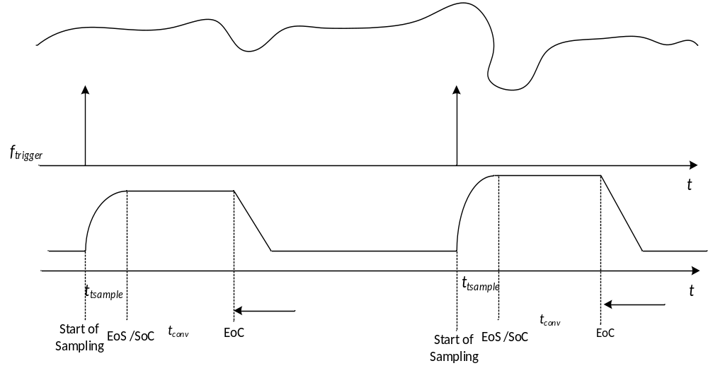
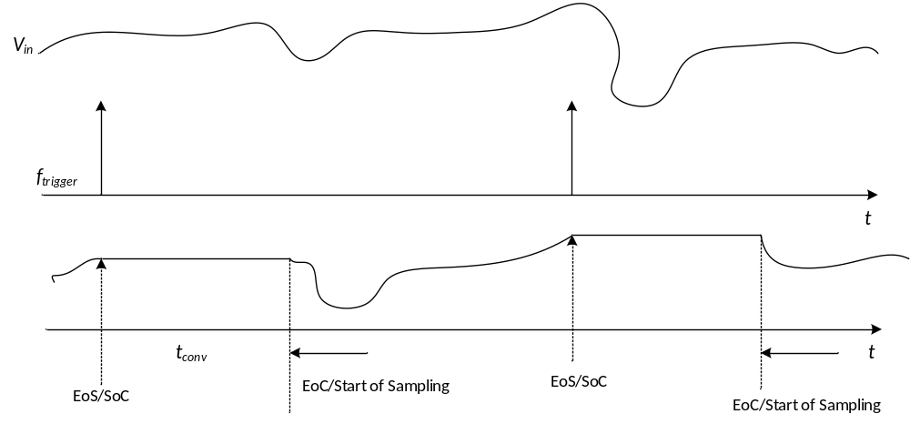

HPPASS: Innovative idle sampling concept holds intrinsic advantages in performance, allows BOM saving
Conventional ADC sampling
Idle ADC sampling
A trigger signal trigger starts the sampling
Sampling goes for t_{sample} time, then the sampled input is converted or put on hold converted.
I_{in} = CdV/dt , dt = sampling time. To reduce sampling time, input current must be high putting a requirement for external cap to supply the charge.
Sampling jitter if sampling time is big and result available only after trigger = t_{sample} + t_{conv}
Trigger signal ends sampling (EoS) and goes into Hold state. If no other input is converted by ADC, the captured sample will be converted hence start of conversion (SoC). After conversion, sampling re-starts with End of Conversion (EoC). After power up of the module, analog input is always sampling.
I_{in} = CdV/dt , dt = sampling time = trigger time period, hence sampling time given by application which is very large. I_{in} is very low and application do not require external cap to provide charge.
No sampling jitter and result available after trigger = t_{conv}

Slide 58
Top-level diagram
The following figure shows the top-level structure of the HPPASS digital system
32 input Triggers ( M6 vs M5 has 16)
Trigger can be Level or pulse
Interrupts can be both individual or combined
Notes:
The key interfaces for the industrial application are triggers and interrupts

Slide 59
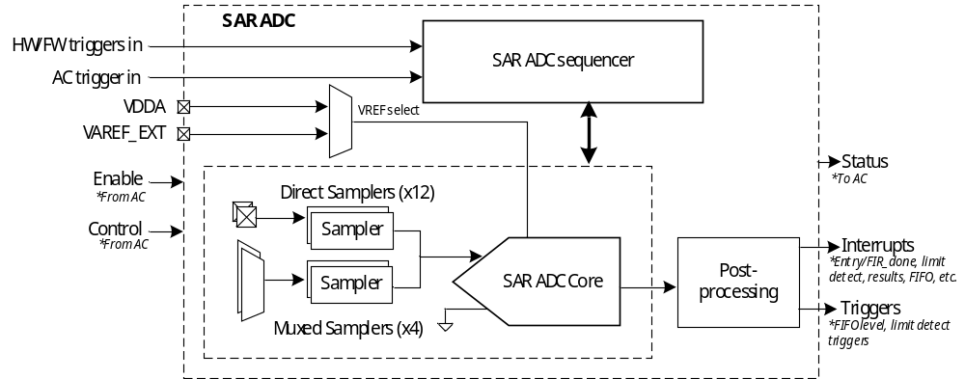
SAR ADC block diagram
SAR sequencer, samplers, ADC core, post-processing
Sequencer supports up to 8 groups
  Each group: up to 16 samplers, individual sample time
  Two priority levels, continuous mode option
Trigger sources: FW / TCPWM / GPIO / autonomous controller
Post-processing: accumulate / averaging / limit-detect / FIFO
Sequencer output feeds TCPWM update / DMA / interrupt
Notes:
To guarantee SAR ADC performance, select the external reference from the VAREF_EXT pin.
When the VDDA supply voltage is less than 2.7 V, the SAR ADC core maximum input frequency reduces to 120MHz, and the SAR ADC maximum sample rate reduces to 6 MSPS.

Slide 60
SAR ADC: Channels
16 Ch ADC via direct pad+ 8 GPIO MUX channel= total 24 ADC Ch
Channel num. | Sampler | Type | Input
0 | Sampler 0 | Direct | AN_A0
1 | Sampler 1 | Direct | AN_A1
2 | Sampler 2 | Direct | AN_A2
3 | Sampler 3 | Direct | AN_A3
4 | Sampler 4 | Direct | AN_A4
5 | Sampler 5 | Direct | AN_A5
6 | Sampler 6 | Direct | AN_A6
7 | Sampler 7 | Direct | AN_A7
8 | Sampler 8 | Direct | AN_B0
9 | Sampler 9 | Direct | AN_B1
10 | Sampler 10 | Direct | AN_B2
11 | Sampler 11 | Direct | AN_B3
12 | Sampler 12 for MUX 0 | MUX0 select 0 | AN_B4
13 |  | MUX0 select 1 | P7.4
14 |  | MUX0 select 2 | P7.5
15 |  | MUX0 select 3 | OpAmp0N[O]
16 |  | MUX0 select 4 | OpAmp2N[O]
17 |  | MUX0 select 5 | CSG DAC OUT
Channel num. | Sampler | Type | Input
18 | Sampler 13 for MUX 1 | MUX0 select 0 | AN_B5
19 |  | MUX0 select 1 | P8.4
20 |  | MUX0 select 2 | P8.5
21 |  | MUX0 select 3 | OpAmp0P[O]
22 |  | MUX0 select 4 | OpAmp2P[O]
23 |  | MUX0 select 5 | Temp sensor
24 | Sampler 14 for MUX 2 | MUX0 select 0 | AN_B6
25 |  | MUX0 select 1 | P7.6
26 |  | MUX0 select 2 | P7.7
27 |  | MUX0 select 3 | OpAmp1N[O]
28 |  | MUX0 select 4 | OpAmp3N[O]
29 |  | MUX0 select 5 | Reserved
30 | Sampler 15 for MUX 3 | MUX0 select 0 | AN_B7
31 |  | MUX0 select 1 | P8.0
32 |  | MUX0 select 2 | P8.2
33 |  | MUX0 select 3 | OpAmp1P[O]
34 |  | MUX0 select 4 | OpAmp3P[O]
35 |  | MUX0 select 5 | Reserved

Slide 61
SAR ADC: Illustration of triggering, sampling and conversion priority
Multiple trigger scenario: a new trigger is asserted for different groups, while the channels of a previously triggered group or groups are being held or converted
Notes:
This illustrates the high and low priority concept, but also exemplifies that once started, all the samplers in that group are completed, before any other group is started

Slide 62
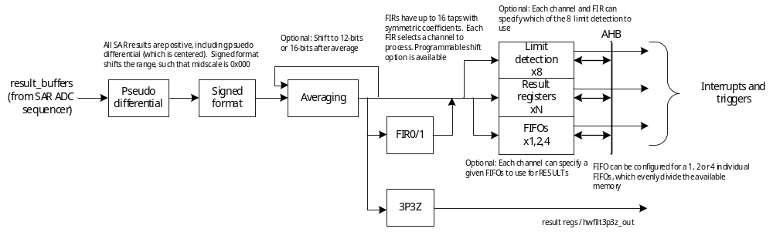
SAR ADC: Post processing
The post processing has the following features:
  Pseudo differential hardware subtraction ( POS Ch –NEG Ch and stores result in POS channel register)
  Signed format
  Averaging(Result accumulation , no shifting function. Support for 2,4,8,16,32,64 results)
  FIR processing ( 16 tap with symmetric coefficients)
  3P3Z processing ( 23 bits output )
  Limit detection ( 8 limit detection source )
  Note: The pseudo differential mode is enabled for a given channel, the averaging mode of this channel must be set to disable.
Notes:
Pseudo differential: Based on a given channel configuration, two samplers can be specified as differential inputs which are sampled simultaneously, converted and subtracted in hardware and presented to the user as one channel result.
Averaging (accumulation of N results) can be set for any channel where N is one of {2, 4, 8, 16}. Note: only accumulates, no shifting

Slide 63
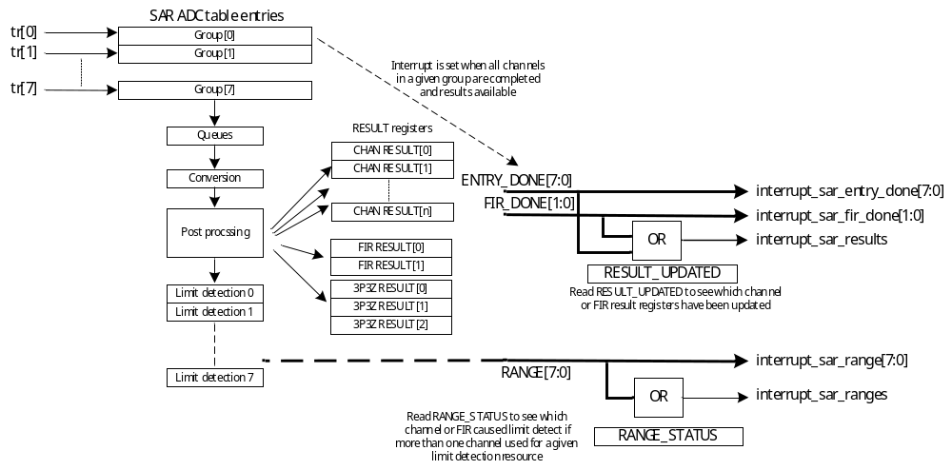
SAR ADC: Interrupts
Notes:
As shown in the following diagram, result interrupts are based on the SAR ADC groups. An interrupt is generated when the channels in a given SAR ADC group are completed and ready for reading from the HPPASS_SAR_CFG_CHAN_RESULTx registers. Similarly, the FIR has associated HPPASS_SAR_CFG_FIR_RESULTx registers and associated FIR_DONE status.
An individual interrupt provided for each group (interrupt_sar_entry_done[7:0]) or FIR done (interrupt_sar_fir_done[1:0]), as well as a combined result interrupt (interrupt_sar_results). If the combined interrupt is used, either the HPPASS_SAR_CFG_RESULT_UPDATED or HPPASS_SAR_CFG_SAR_RESULT_INTR registers must be read to determine the cause of the interrupt.
Limit detect interrupts generate when a channel or FIR result is above/below a threshold or inside/outside two thresholds. The individual interrupt (interrupt_sar_range[7:0]) provided for each limit detection resources and combined limit detect interrupt (interrupt_sar_ranges).

Slide 64
Comparator and slope generator (CSG)
Analog comparators with 10-bit,30Msps DAC-generated threshold
Slope generation via DAC direct / buffered / LUT writes
Programmable hysteresis 0 … 84 mV (M6)
Deglitching filter on comparator output
Outputs feed TriggerMux → TCPWM kill / gate
Count
  PSC3M5: 5 CSGs
  PSC3M6: up to 9 CSGs in up to 3 groups
The diagram is considered a “slice”, and the PSOC™ Control C3 MCU supports nine slices
Notes:
There are two logic partitions “wrapped” around the CSG analog subblock, one for the DAC code generation, and the other for comparator output post processing.

Slide 65
CSG: 10-bit DAC
There are various modes of generating and controlling the DAC codes. It contains the following modes:
  Direct firmware control of DAC code
  Buffered firmware control of DAC code
  Two-value (Hysteretic) control of DAC code
  Automatic DAC ramp generation
  Look-up table (LUT) for DAC arbitrary waveform generation
Notes:
An AHB-accessible DAC_VAL, which directly drives the DAC code
Two DAC buffers, DAC_VAL_A and DAC_VAL_B, the definition of which depends on the selected mode
A programmable slope generator with parameters START, END, DAC_STEP, DAC_PERIOD
A period counter with fractional capability to precisely modulate the slope of a given ramp or waveform
A START trigger (to start a configured mode) and UPDATE trigger (to advance to next code), which can be hardware, firmware, or AC (or PERIOD for UPDATE)
Status for HW_START, SLOPE_DONE and BUFFER_EMPTY for interrupt generation

Slide 66
CSG: Post processing
Comparator remapping
The main features are as follows:
  Configurable comparator-output polarity
  Comparator blanking by a selected level trigger
  Edge-based blanking after rising and/or falling transitions on the blanking trigger
  DAC-code-change blanking to avoid false comparator transitions while the reference changes
  Comparator-output deglitching with a programmable stable-time requirement
  Comparator output remapping
    Comparator outputs 0-2 are combined to form csg_comp_out0
    Comparator outputs 3-5 are combined to form csg_comp_out1
    Comparator outputs 6-8 are combined to form csg_comp_out2
  Positive-edge, negative-edge, or both-edge interrupt generation
  Comparator output or inverted output can be used as an update trigger, enabling hardware hysteretic operation

Slide 67
3P3Z hardware compensator ( PSC3M6 only)
3 × programmable 3-pole 3-zero digital filters
16-bit input (q0.15), 24-bit output (q0.23)
48-bit multiplier, 58-bit accumulator
Anti-windup, saturation, offset, range-limit stages
Max latency 9 CPU clock cycles per sample
Runs voltage and current loops without CPU intervention
Coefficients loaded from AHB (offline design flow)
Input can come from software or the HPPASS data path
Filter completion can generate HPPASS triggers and interrupts.
Programmable data path

Slide 68
3P3Z Filter (3P3ZFILT) Dedicated Datapath
ADC → 3P3Z → TCPWM (M6 only)
ADC channels 0–35 selectable per 3P3Z instance
Output feeds TCPWM_GRP0_CNTx_CC1 directly
Closed-loop period ≈ ADC done + 9 cycles + PWM update
Deterministic, hardware-only control loop
Trigger MUX pulse forwards to other peripherals
Enables MHz-range digital power conversion entirely in hardware
Supports hardware-based PWM control and filter-done triggers reducing control-loop latency by avoiding CPU interrupts

Slide 69
3P3Z Filter (3P3ZFILT) - Control-Loop use case
Derive 3P3Z coefficients from the plant model and sampling frequency
Convert coefficients to the required fixed-point format
Verify input scaling, GIN, GOUT, and offset settings
Set output limits based on PWM/actuator range
Configure anti-windup for saturation handling
Ensure ADC → Filter → PWM timing fits within the control period
Monitor FILTER_BUSY and filter-done events during testing
Validate stability, transient response, and fault recovery on hardware

Slide 70
Operational Amplifier (OpAmp)/AFE
PSC3M6 only
4 × fully differential, rail-to-rail OpAmps
Supports PGA, differential amplifier, buffer, and standalone OpAmp modes
Inputs selectable from pins, GPIOs, DAC, reference, or ground
Configurations
  Standalone (external feedback network)
  Internal PGA: 1× / 2× / 4× / 8× / 16× / 32× / 64×
  Single-ended or differential to ADC MUXed sampler
Four configurable register sets support dynamic reconfiguration
Outputs can connect directly to HPPASS ADC channels for signal conditioning and conversion
Eliminates external op amps for shunt-current sensing
Notes:
The HPPASS analog front end (AFE) provides four configurable OpAmps for signal conditioning ahead of the ADC or an external load.

Slide 71
OpAmp runtime configuration update
Each OpAmp supports 4 configurable operating modes (AFE_CFG0 to AFE_CFG3)
All four configurations are preloaded into dedicated configuration registers
One configuration must be selected for active operation
Configuration Selection Methods
  Firmware-Controlled Selection
    Use AFECONFIG_CTRL.MUX_CTRL[2:0]
    Select any configuration: 0, 1, 2, or 3
  Trigger-Based Selection
    Enable a level trigger to switch between two configurations
    Trigger = 0 → Selects EVEN configuration
    Trigger = 1 → Selects ODD configuration
    Supports dynamic runtime configuration switching without firmware intervention
Enables fast mode changes and application-specific reconfiguration during operation

Slide 72
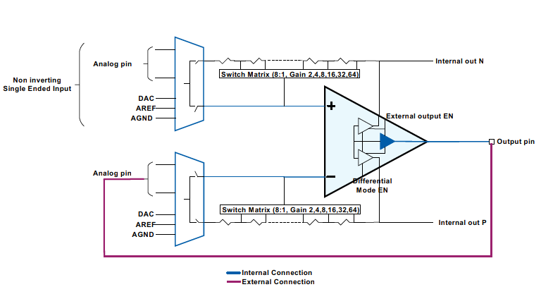

Opamp configurations
Example- Standalone OpAmp
Unity gain amplifier with external output
Shunt current amplifier with offset for motor control

Slide 73


Opamp configurations
Example-PGA
Programmable gain amplifier with single-ended input and internal single ended output
Programmable gain difference amplifier with internal single-ended output

Slide 74
Digital to analog converter (DAC)
2 × 12-bit monotonic R2R DACs with output buffers
Full scale range : min 1.71V to max VDDA
Up to 1 MHz update rate with 1 µs settling time
±1 LSB accuracy and < 2 mV glitch
Output drives
  External pin (10 mA, 100 pF)
  OpAmp input for further conditioning
  ADC input for internal calibration or feedback
Supports external or supply reference selection
Rail-to-rail output can drive MCU pins
DAC output can be routed internally to ADC inputs for loopback and testing
Uses: threshold generation, DC bias, waveform, slope compensation

Slide 75

On Chip Temperature sensor
Has an on-chip temperature sensor that is used to measure the internal die temperature
  It consists of a single bipolar junction transistor (BJT) in diode configuration, its base-to-emitter voltage ($V_{BE}$) has a strong dependence on temperature, measure the $V_{BE}$ of the transistor using the ADC to calculate the die temperature.
$Ratio={\left(V_{BE1}−V_{BE2}\right)}/{V_{BE2}}$
  $V_{BE2}$: The temperature sensor is biased with a 1 uA
  current by default, this output corresponds
  to the measurement $V_{BE2}$.
  $V_{BE1}$: By setting TEMPSENSE_CTRL register, an
  additional 8 uA flows into the BJT, this
  corresponds to the measurement $V_{BE1}$.
Die temperature can be calculated as given in the following equation:
  $Temperature=A∗{Ratio}^{3}+{B∗Ratio}^{2}+C∗Ratio+D$
    * The constant A, B, C, and D are stored in the SFLASH registers during factory calibration.
Notes:
The temperature sensor consists of a single bipolar junction transistor (BJT) in the form of a diode, the transistor is biased using the reference current from the analog reference block (AREF) with two bias currents 1uA and 8 uA. Its base-to-emitter voltage ($V_{BE}$) has a strong dependence on temperature at a constant collector current and zero collector-base voltage.
This property is used to calculate the die temperature by measuring the $V_{BE}$ of the transistor using the ADC.

Slide 76
HPPASS Clock
HPPASS requires only a single clock, CLK_HF0 with a maximum frequency of 180 MHz
  SAR ADC core clock directly use CLK_HF0 clock
  SAR ADC digital part, AC, INFRA clocks are fixed at CLK_HF0/2
  CSG clock can be configured separately by peripheral clock divider group 0 that source clock comes from CLK_HF0, rang from 10 MHz to 90 MHz

Slide 77
Lab3: How to import MTB based code example
Steps:
Create a new ModusToolbox™ application
  From the Quick Panel, Click on Start, and then click New Application.
  Alternatively, you can choose File > New > ModusToolbox™ Application.
Select a target PSOC™ development kit, in the Choose Board Support Package (BSP) dialog, choose the Kit Name, choose KIT_PSC3M6_EVAL, Click Next
Select desire code example - CE under Template application and click create
Project structure been added to the workspace
1
b
a
2
3
4

Slide 78


Lab3: ADC HW3P3Z filter TCPWM data path
https://github.com/Infineon/mtb-example-ce243300-adc-hw3p3z-tcpwm-hw-path
This code example demonstrates the capabilities of the PSOC™ Control C3M6 MCU to transfer data between ADC, HW3P3Z filter, and TCPWM without CPU intervention
Rotate the potentiometer on the EVAL and monitor LED brightness varying to see the datapath working

Slide 79





Lab3: ADC HW3P3Z filter TCPWM data path
TCPWM configuration
HPPASS configuration
3P3Z filter Datapath

Slide 80
Session:
Real time control subsystem -TCPWM
TCPWM
MOTIF
HRPWM

Slide 81

TCPWM – Overview
Features
Benefits
16× 16-bit and 8× 32-bit timer, counter, and PWM instances on PSC3M/P6
Multi-phase PWM generation with a flexible timer structure
High-resolution PWM (HRPWM) with typical resolution < 100 ps
2× Motion Interface (MOTIF): quadrature decoder, Hall sensor, multi-channel
Glitch filter and advanced dithering functions
KILL input forces PWM outputs to a safe state
Programmable dead-time complementary outputs
Flexible PWM for many motor and power-control topologies
Hardware states for sensored BLDC control via MOTIF
<100 ps resolution enables clean waveforms and high fsw scalability
Hardware glitch filter reduces input noise and software effort
Dithering minimizes EMI/EMC impact
Immediate hardware KILL protects FETs without CPU intervention
Notes:
Cover the headlines: 16+8 counters, multi-phase PWM, HRPWM <100 ps, 2x MOTIF, glitch filter, dithering and hardware KILL. Benefit story: flexible topologies, sensored BLDC in hardware, clean high-frequency waveforms and FET protection without CPU latency.

Slide 82

TCPWM – timer / counter / PWM
3 counter groups on M5–16-bit ×2 + 32-bit ×1- total 20 counters
3 counter groups on M6–16-bit ×2 + 32-bit ×1 (double counterd on the 32-bit)- total 24 counters
Modes: Timer, Counter, Capture, PWM (edge/center/asym/pseudo-random)
Shadow update: duty, period, dead-time, dithering
Comparator-based kill (immediate or synchronous)
21 trigger input sources per counter
Independent clock pre-scaling and dead-time per counter
Enabled TCPWM Quad mode inside counter for Group1 and Group2
HRPWM: 65 ps typ (M5) / <100 ps (M6)

Slide 83


QUAD ENCODING MODE – TCPWM Group 0 and 1
PSC3M/P6 only
QUAD X1, X2 and X4 mode
Quadrature functionality increments/decrements a counter between 0 and the maximum value 0xffff/0xffffffff or PERIOD , depending on QUAD_RANGE_MODE.
Counter updates are under control of quadrature signal inputs: index, phiA and PhiB.
The index input is used to indicate an absolute position.
The phiA and phiB inputs are used to determine a change in position (the rate of change in position can be used to derive speed).
QUAD_ENCODING_MODE specifies the quadrature encoding scheme
IT can be X1/X2/X4 or up/down rotary mode
Counter increments ( incr1 event ) and decrements (decr1 event) are determined by the quadrature encoding scheme
With UP_DOWN encoding (up/down rotary count mode) the counter is incremented by phiA and decremented by phiB.
QUAD up down rotary mode

Slide 84



Dead-time generation when line_sel.out_sel is changed to 1
PSC3M/P6 only
Line_sel.out_sel can be updated by the SW to either select PWM, inv PWM, Motif or constant levels like 0 or 1
line_out” and “line_compl_out” can individually selects different output per settings of registers “LINE_SEL.OUT_SEL” and “LINE_SEL.COMPL_SEL
The IP is updated to ensure dead-time is generated whenever line_sel.out_sel is changed to 1 and a positive edge on line_out occurs in PWM_DT mode.
A dead-time is generated when line_sel.out_sel transitions to 1 and a positive edge is detected on line_out
A dead-time is generated when line_sel.compl_out_sel transitions to 1 and a positive edge is detected on line_compl_out

Slide 85


Immediate compare of updated values in CC0,CC1,PERIOD & DT match
PSC3M/P6 , C3M/P8 only
Immediate compare of updated values in CC0, CC1, PERIOD and DT match should come into effect in the same period. Changing the compare condition from “=” to “≥” and “≤” respectively.
The changes are applicable for a counter irrespective of whether HRPWM is present or not
This feature should be supported for the following counter compare values
  CC0 Match
  CC1 Match
  Period Match
  DT-Time( Dead Time) Match
When counter value is equal to cc0 value, cc0 match will trigger. With the new implementation the CC0 event should happen also when the counter has already passed the new assigned value.

Slide 86

External Event Based Mode to control Duty cycle
PSC3M/P6 , C3M/P8 only
This mode supports an external trigger-based duty cycle control. In this mode the duty cycle shall not be given by CC0 or CC1 match.
The external trigger signal can be a HW generated signal or generated by FW.
Modes will be supported for the following settings:
  PWM and PWM_DT mode
  Dual Slope Mode (UPDN1/2 mode)
  With or without HRPWM mode enabled
  Duty information is always dependent on period irrespective of whether Period is generated by external event or by PERIOD (PI/PF) values and maintained at 50%. CC0- and CC1 Registers are not used in this case.
This mode shall be supported to the serve the need of special handling in LLC topologies where the external trigger controls the duty and the period of the HRPWM signal

Slide 87


Masking of the PWM output signal based on trigger signal
PSC3M/P6 , C3M/P8 only
  Therefor a specific masking feature controlled during run-time by SW/FW and it ensure that LINE_OUT/LINE_COMPL_OUT of two counters would not transition to high at the same time.
  The main functionality is to enable masking of the “line_out” signals in correlation with the Mask input signals.
  The Trigger inputs will be used as Mask inputs. The Mask signals will be connected to input bits of the existing trigger inputs.
  PWM output masking is a run-time configurable feature controlled by SW /FM. The mask feature can be enabled / disabled anytime while the counter is enabled or is running
  Masking is supported for the following Counter Modes
    PWM, PWM_DT
    For all count modes including COUNT_UP, COUNT_DOWN and UPDN1/2
  Immediate KILL shall have higher priority than MASK feature on line_out/line_compl_out. Other kill modes would be masked normally.
  For power conversion topology, controlled by non-complimentary PWM outputs signals from two counters, it is required to avoid overlapping PWM signals (outputs = “1”) to avoid short circuit current flow.

Slide 88

MOTIF – autonomous BLDC / Hall / Quad-encoder
Autonomous block commutation for BLDC / PMSM
Hall sensor decode + quadrature encoder decode
LUT-based commutation pattern (128-entry LUT)
Standalone multi-channel PWM mode
Direct link to TCPWM group of 4 counters
Derives speed and position without CPU load
M5–1 × MOTIF (single motor)
M6–2 × MOTIF (dual motor, e.g. compressor + fan)

Slide 89

MOTIF connection scheme – PSC3M6
Hall / quad inputs feed low-pass filter → Hall Sensor Decode block
MOTIF.HSD produces commutation pattern
MOTIF.EWHE flags erroneous hall events
MOTIF interface drives TCPWM group counters
MOUT bits map to individual PWM output lines (0 / 1 / PWM / inverse PWM)
Enables autonomous six-step commutation for BLDC block modulation

Slide 90



MOTIF –Multichannel pattern influence on PWM output
PSC3M/P6 only
MOTIF output are mapped to Line_out and line_compl_out
MOTIF interface support 0,1,PWM and inverse PWM( Only M/P6) logic .

Slide 91

CORDIC – CoOrdinate Rotation Digital Computer
Kernel executes 4 iterations per clock; 28 iterations per operation
About 10 CPU clocks per operation: seven kernel cycles plus three setup cycles
Operating modes
  Circular rotation (sin, cos)
  Circular vectoring (atan2, magnitude)
  Hyperbolic rotation / vectoring (sinh, cosh, exp, ln)
  Linear (mul, div)
24-bit two's-complement inputs; Q-format friendly
Access modes: bus hold, polling, DMA trigger, interrupt

Slide 92

LPComp – low-power comparators
2 × LPComp active in Active, Deep Sleep and Hibernate modes
Three power modes selectable per comparator
  Normal / Low-power (Active + Sleep)
  Ultra-low-power (Deep Sleep + Hibernate)
Configurable input via switch matrix (internal + pin)
Internal reference 0.4–0.8 V (uncalibrated)
One-sided hysteresis option per comparator
Output to GPIO or TriggerMux → TCPWM
Wake-up source in Hibernate (asynchronous)

Slide 93

ModusToolbox™ software support
Users can use Infineon’s ModusToolbox™ software to configure the HPPASS in device configurator for PSOC™ Control C3 MCU
  When HPPASS configured in device configurator, the device configurator will auto-generate configuration structure and codes based on user’s settings, users need to call cybsp_init() at the start of main() to initialize HPPASS

Slide 94
ModusToolbox™ software support – PDL driver
API functions are provided to use HPPASS HW block. All under HPPASS (High Performance Programmable Analog Sub-System). Here an abstract of few PDLs:
HPPASS driver functions
  Cy_HPPASS_Init(const cy_stc_hppass_cfg_t * cfg)
  Cy_HPPASS_SAR_IsBusy(void)
  Cy_HPPASS_SetFwTrigger(uint8_t mask)
HPPASS SAR ADC driver functions
  Cy_HPPASS_SAR_Result_GetStatus(void)
  Cy_HPPASS_SAR_Result_ChannelRead(uint8_t chanIdx)
  Cy_HPPASS_SAR_Result_ClearStatus(uint32_t mask)
HPPASS CSG driver functions
  Cy_HPPASS_DAC_Start(uint8_t sliceIdx, cy_en_hppass_dac_cmd_t command)
  Cy_HPPASS_DAC_SetValue(uint8_t sliceIdx, uint16_t value)
  Cy_HPPASS_DAC_ClearInterrupt(uint32_t interrupt)
HPPASS AC start function
  Cy_HPPASS_AC_Start(uint8_t startState, uint16_t timeoutUs)
Note: here are just a few of the functions listed, please refer to the ModusToolbox™ PSC3M6 Device Support Library (DSL) documentation for more functions and details. That contains functions for 3P3Z Filter, OpAmp, DAC, etc.

Slide 95
Code examples
Infineon provides the following code examples to guide user how to use the HPPASS in ModusToolbox™:
  PSOC™ Control MCU: HPPASS SAR ADC basic
    This example demonstrates how to use HPPASS SAR ADC to measure the external input voltage in Infineon's PSOC™ Control C3 MCU devices.
  PSOC™ Control MCU: kill PWM cycle-by-cycle using HPPASS CSG
    This example configures an internal 10-bit DAC of CSG to generate rising slope on the negative input of the comparator, compare this slope signal with the external input signal cycle-by-cycle to adjust the PWM duty cycle.
  PSOC™ Control MCU: HPPASS SAR ADC differential measurement
    This example demonstrates how to use a high-performance programmable analog subsystem (HPPASS) SAR ADC pseudo-differential feature to measure the differential inputs voltage in Infineon's PSOC™ Control C3 MCU devices.
  PSOC™ Control MCU: HPPASS on-chip temperature sensor
    This example demonstrates how to read the internal temperature of Infineon's PSOC™ Control C3 MCUs through the on-chip temperature sensor, SAR ADC, and autonomous controller (AC) of high-performance programmable analog subsystem (HPPASS). The temperature value can be displayed on a UART terminal using the user button.

Slide 96
Code examples (cont.)
  PSOC™ Control MCU: AFE
    This code example demonstrates how to use the Analog Front End (AFE) on PSOC™ Control C3M6 MCUs. The user can increase the gain by pressing the user button and visualize the gain output on the terminal.
  PSOC™ Control C3 MCU: HW 3P3Z Filter as LPF
    This code example applies to PSOC™ Control C3M6 MCUs. It demonstrates ADC, hardware filter, and DAC operation together.
  PSOC™ Control MCU: DAC
    This is a code example for PSOC™ Control C3M6 MCUs. It demonstrates generating analog output using a DAC. This code example can generate three types of outputs: Sine wave, Sawtooth wave and Fixed output.

Slide 97

Lab4: AFE(Analog Front End)-Opamp
https://github.com/Infineon/mtb-example-ce242695-afe
    This code example demonstrates how to use the Analog Front End (AFE) on PSOC™ Control C3M6 MCUs.
    The user can increase the gain by pressing the user button(USER_BTN2) and visualize the gain output on the terminal.

Slide 98


Lab4: AFE-Opamp

Slide 99


Lab5: DAC
https://github.com/Infineon/mtb-example-ce242673-dac
This is a code example for PSOC™ Control C3M6 MCUs. It demonstrates generating analog output using a DAC.
This code example can generate the following three types of outputs.
  Sine wave
  Sawtooth wave
  Fixed output
Monitor the generated waveform on an oscilloscope connected to AN_A5.

Slide 100


Lab5: DAC

Slide 101
Session:
Communication Subsystem Deep Dive
UART
IIC
SPI
PMBus
I3C
CAN-FD
USB-FS

Slide 102
Communication landscape – PSC3M5 vs PSC3M6
Common to both parts
  6 × SCB (each I²C / SPI / UART / LIN / IrDA / Smart Card master or slave)
  1 SCB Deep-Sleep-capable (I²C slave / SPI slave wake-up)
  1 SCB with fast SPI up to 45 MHz
  2 × CAN FD: one instance up to 8 Mbps, ISO 11898-1:2015
PSC3M6 additions
  1 × SCB with PMBus v1.4 / SMBus v3.2 (≤ 1 Mbps, HW address matching)
  1 × I3C v1.1 controller with over-voltage-tolerant I/O
  1 × USB Full-Speed host / device with integrated PHY

Slide 103
SCB – Serial Communication Block
Six identical SCB instances can be reconfigured at runtime
Protocol modes
  I²C: master / slave / multi-master + EZ-I²C, 100 k / 400 k / 1 M
  SPI: Motorola / TI / NS, master / slave + EZ-SPI, up to 50 MHz
  UART: standard / multi-processor / half-duplex / LIN / IrDA / 7816
128-byte TX + 128-byte RX FIFO per SCB
Independent TX / RX DMA request lines
Programmable data frame 4–16 bits, half-bit STOP resolution
Deep-Sleep operation on SCB0 (I²C / SPI slave wake)
Interrupts: TX empty, RX full, error flags, address match

Slide 104
SCB
Serial Peripheral Interface
SPI
    Supports up to four slave select lines
    Supports three SPI protocols
    SPI Buffer mode
  FIFO mode – includes Rx/Tx FIFOs
  EZSPI mode - master uses 8-bit EZ address in the slave memory to write or read data
  Command-response mode- support SPI slave mode only, has two phases of operation : write and read phase
Configuration | TX/RX FIFO depth | Data width | Use case
FIFO mode | 128 / 64 / 32 | 8/16/32-bit | General high-speed transfer
EZ mode | 256-byte single buffer | 8-bit | Simple slave memory access
CMD_RESP mode | 256-byte single buffer | 8-bit | Deep Sleep slave (SCB[0])

Slide 105

SCB
UART
  The UART in the SCB block supports the following:
  Standard UART: TX and RX connection
  Half duplex: parralel transmission and reception is not supported
  Multi-processor mode :Single master –multi slave connection
  Start skipping function: to wake up from deep sleep mode
  Oversampling : used to synchronise the receiver with the transmitter
  Break detection: used by transmitter to signal the special condition to the receiver
Start skipping

Slide 106


SCB
IIC
  I²C supports the following:
  Standard I²C :SDA /SCL
  I²C Buffer mode
  FIFO mode¹
  EZI2C mode
  Command-response mode
  Glitch filtering- support Analog and Digital glitch filter
¹ FIFO mode has the same features as SPI

Slide 107

SCB
System integration
SCB is interconnected with several modules in the MCU system.
Interrupt: To generate interrupt
IO subsystem: Signal connection to the Input and Output pins. Using SMARTIO to redirect the SCB pin to other peripherals or loopback
Trigger Mux: If SCB does not have direct connection to peripheral, the signal can be mapped to Trigger Mux module and connected to SCB. Use Tigger Mux to start/stop/reset the peripherals
TCPWM: Input signal to TCPWM module through trigger mux
DMA: To transfer data without CPU intervention

Slide 108

SCB
DMA and trigger interconnection
This is an example of transferring the transmit data from RX-FIFO to RAM by DMA while using the SCB UART mode.
0. Configure DMA for 1D transfer from peripheral to memory
In addition, configure the UART and trigger multiplexer
UART RX interrupt occurs
CPU notifies a software trigger to DW via the trigger multiplexer
DMA reads the descriptor from the specified area (Descriptor pointer) when accepting the transfer
DMA reads the data from the source address (SCB_RX_FIFO_RD), and writes the read data to the destination address (RAM base address). After that, DMA does increment the source address and the destination address by 0x04. Then, DMA reads the data from the source address (SCB_RX_FIFO_RD) and writes it to the destination address (RAM base address +0x04) again
DMA notifies the CPU with an interrupt when all transfers are completed
The CPU accepts the interrupt and reads the port states in the RAM

Slide 109
PMBus / SMBus SCB – M6 only
One SCB additionally supports PMBus v1.4 / SMBus v3.2
Baud rate up to 1 Mbps
Hardware address screening
  Minimum 5 slave-address masks (MSAs)
  Autonomously reject or NACK non-matching addresses
Generate timeout events for invalid or stalled commands
Native compliance targets
  Server / telecom PSU (telemetry + alerts)
  Multi-rail digital power modules with PMBus command set
  Battery-management (SMBus)
Works alongside CAN FD for external gateway communication

Slide 110
CAN FD – flexible data-rate CAN
2 × Bosch M_TTCAN v3.3.0 controllers: classic CAN + CAN FD + TT-CAN
The data phase reaches 8 Mbps on one instance and 5 Mbps on the other
Standard (11-bit) and extended (29-bit) identifiers
Shared Message RAM (ECC-protected)
  Dedicated TX buffers + configurable TX FIFO / TX Queue
  Filter list separate from message list
  MRAM can be turned off in Deep Sleep to save power
Two interrupt lines (int0 + int1)
Transmitter delay compensation for fast CAN FD data phase
Loopback / test mode for on-chip development
Trigger inputs from TriggerMux (wake on RX activity)

Slide 111
CAN FD – Message RAM and ECC
Message RAM structure: 5 sections
  Standard ID filter list
  Extended ID filter list
  Rx FIFO 0 / Rx FIFO 1 / Rx Buffer
  Tx Event FIFO for post-processing
  Tx Buffer: dedicated buffers + optional Tx FIFO or Tx Queue
ECC generator + checker on every access
  Single-error correction, double-error detection
  ECC-error injection for validation
  Address-error detection
Design tip: size the Rx FIFO for the worst-case burst rate and ISR latency

Slide 112

I3C subsystem – M6 only
I3C v1.1 controller with over-voltage-tolerant I/O
Ensure reliable transmission and reception of data
Backward-compatible with legacy I²C targets
Provides more throughput than I²C with fewer pins than SPI
Device on I3C bus can be
  Primary controller
  Secondard controller
  I3C target or a I2C target
Feature set
  In-band interrupts, hot-join, dynamic address assignment
  Direct + broadcast Common Command Codes (CCC)
Typical uses
  Current sensors / battery gauges / MEMS on motor + power boards
  Reduces wiring while supporting burst-rate telemetry

Slide 113

I3C Architectural Block
CLK_SYS : used to generate clocks for controlling the AHB interface
CLK_IF: used to generate the CORE_CLK interface
CORE_CLK is used to control all I3C related functionality in the controller mode of operation
Core_Clk> 10x desire frequency on the SCL line
Async counter used by I3C when operating in the asynchronous timing
I3C Controller mode allows addressing upto 11 target devices
SRAM 1KB(256x32bit) is for command /response queues and transmit /receive data buffers

Slide 114

USB-FS device + host – M6 only
Full-Speed 12 Mbit/s device + host block with integrated PHY
VDDUSB rail 3.0–3.63 V (LQFP-100 package only)
Typical uses
  Field firmware update over USB (custom or DFU class)
  HID-class service tools and control panels
  Mass Storage bootloader or logging
Boot-ROM DFU + application-class USB stacks in middleware

Slide 115
USB Device Block
Architecture and core blocks
Integrated USB PHY
Physical layer via D+, D−, VBUS; handles differential signalling, VBUS detection, and USB bus events (SE0, suspend, and resume)
Serial interface engine (SIE)
Manages USB protocol, including token/data/handshake packet processing, CRC generation/checking, and bit stuffing
Arbiter (memory and bus arbitration)
Manages access to endpoint memory between the CPU, DMA, and SIE
512-byte SRAM
Shared buffer for EP1 to EP8, with allocation controlled by firmware or hardware
CPU / DMA subsystem
Interfaces the USB block with the system CPU / DMA for data read/write
Notes:
The USB device block consists of four primary components. The USB PHY handles physical signaling and bus monitoring. the serial interface engine, or SIE, manages USB protocol processing such as token decoding, CRC handling, and handshake responses. The arbiter controls memory access between the CPU, DMA, and USB hardware. Finally, the local SRAM buffer stores endpoint data during transfers.

Slide 116
USB Host Block
Architecture and core blocks
USB PHY
  Handles D+, D− signaling, pull-down resistors, and VBUS detection
Host controller unit
  Manages enumeration, scheduling, token generation, and transfer control
Endpoint n (n=1, 2)
  Stores transmit and receive data packets, the maximum buffer size of endpoint 1 is 256 bytes and that of endpoint 2 is 64 bytes
Interrupt control block
  Reports connection, transfer completion, and error events to CPU
DMA request (DREQ) control
  Supports data transfer using DMA, two DMA transfer modes are Automatic data transfer mode and packet transfer mode
Notes:
The Host controller consists of the USB PHY, host controller unit, endpoint buffers, DMA request logic, and interrupt logic.
The USB host block has two physical endpoints (EP1 and EP2). EP1 has a larger buffer (256 bytes) than EP2 (64 bytes), so high-throughput transfers should use EP1 as primary.
The DREQ control block generates independent DMA request signals for each endpoint.

Slide 117
USB Host
Example -Data transfer
USB host communication follows three phases which are token, data, and handshake to control data flow and integrity
PSOC™ Control C3 (PSC3x6) MCU supports issuing these packets by setting the registers
  Token packet: Initiates all transactions; carries PID, address, and endpoint number
    IN, OUT, SOF (start of frame) or SETUP token
  Data packet: Carries actual payload data following a token packet
    Device or host transfers DATA0 and DATA1
  Handshake packet: Confirms or rejects data reception
    ACK: Transfer successful
    NAK: Not ready
    STALL: Endpoint halted
Token packet
Data packet
Handshake packet
Notes:
A USB transaction consists of three phases: Token, data, and handshake. Token packets initiate communication, data packets carry the payload, and handshake packets indicate transfer status. Common handshake responses include ACK for success, NAK for not ready, and STALL for endpoint halt conditions.

Slide 118

USB
ModusToolbox™ software support
Infineon’s ModusToolbox™ software provides
emUSB-Device and emUSB-Host middleware, enabling users to easily use the USB peripheral of the PSOC™ Control C3 (PSC3x6) MCU
Infineon has licensed emUSB-Device from SEGGER and offers it for free to its customers
Users can use the Library Manager tool to add emusb-device middleware or emusb-host middleware in the project
Lib Features
  High performance
  Can be used with or without an RTOS
  Easy to use
  Easy to port
  No custom USB host driver is necessary
See the emUSB-Device API Reference for a quick start guide
Notes:
Infineon provides SEGGER emUSB middleware packages through ModusToolbox. Developers can easily add either emUSB-Device or emUSB-Host using Library Manager and integrate USB functionality into their application project.

Slide 119
USB
Code examples
Infineon provides the following USB code examples to guide users on how to use the USB device mode or host mode using emUSB-Device or emUSB-Host middleware in ModusToolbox™
emUSB-Device - HID mouse application: This code example demonstrates how to set up a USB HID descriptor to implement a 3-button mouse. After the device enumerates, the firmware moves the mouse cursor on your computer from the right to the left, and vice versa
emUSB-Device – HID generic application: This code example demonstrates the usage of the emUSB-Device middleware stack to configure the USB block as a generic human interface device (HID), which uses an external HID software tool to send in the generic HID inputs, which it then relays back
emUSB-Device – CDC echo application: This example shows how to use Segger’s emUSB-Device middleware to set up the USB block for the communication device class (CDC). Once configured for CDC, the Infineon MCU device gets enumerated as a virtual COM port, which can be read and written by a terminal emulator program on a PC
emUSB-Host – CDC echo application: This code example shows how to set up a USB block as a communication device class (CDC) host using the emUSB-Host middleware. It implements echo functionality from the host side and requires a USB device configured to echo the CDC signals back to the host
Notes:
The examples cover HID, CDC, and Host-based communication use cases. The HID examples demonstrate USB peripheral implementation, while the CDC examples show virtual COM port communication. The Host CDC example demonstrates enumeration and communication with an external CDC device from the host side. These projects are excellent references for understanding USB software architecture and middleware integration.

Slide 120


Lab6: emUSB-Device - HID mouse application:
Import the code from PSC3M6_EVAL BSP under peripherals
https://github.com/Infineon/mtb-example-ce242723-usb-device-hid-mouse
Build and flash the code to the kit
After programming, the application starts automatically. Confirm that "emUSB Device: HID mouse application" is displayed on the UART terminal
Connect the board to your PC using another USB cable through the USB device connector (see the kit user guide for its location)
Observe that the mouse cursor periodically moves left and right

